Slide 1
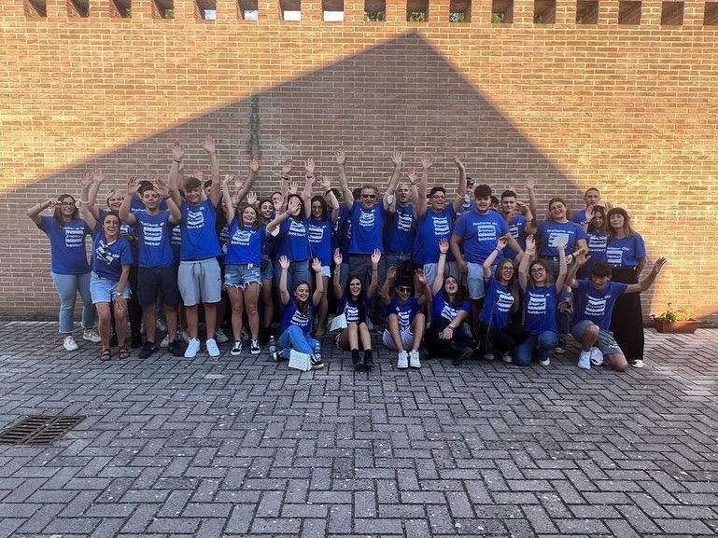
ERASMUS+ 2022 Chania

Slide 2
M.a.i.Ch.
Daphne Barone

Slide 3
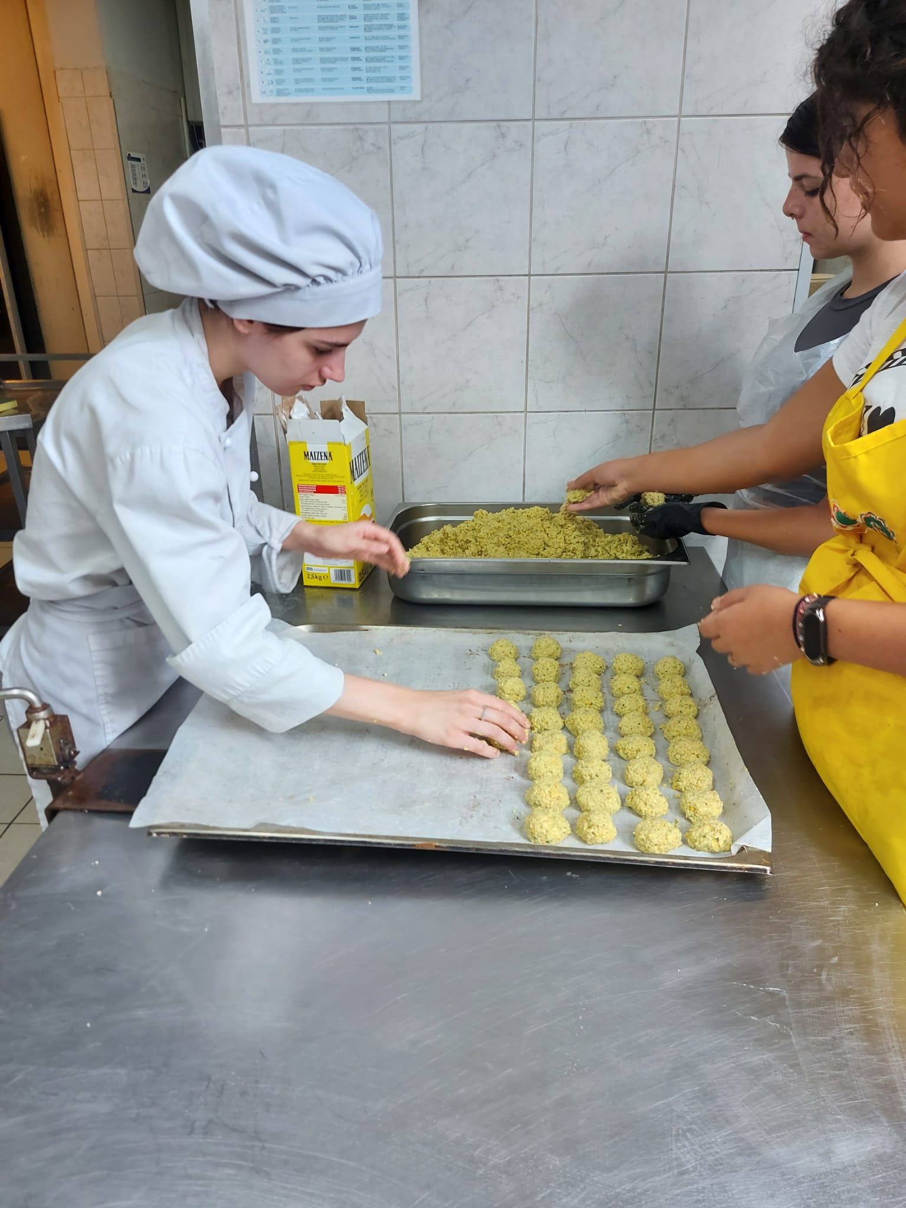
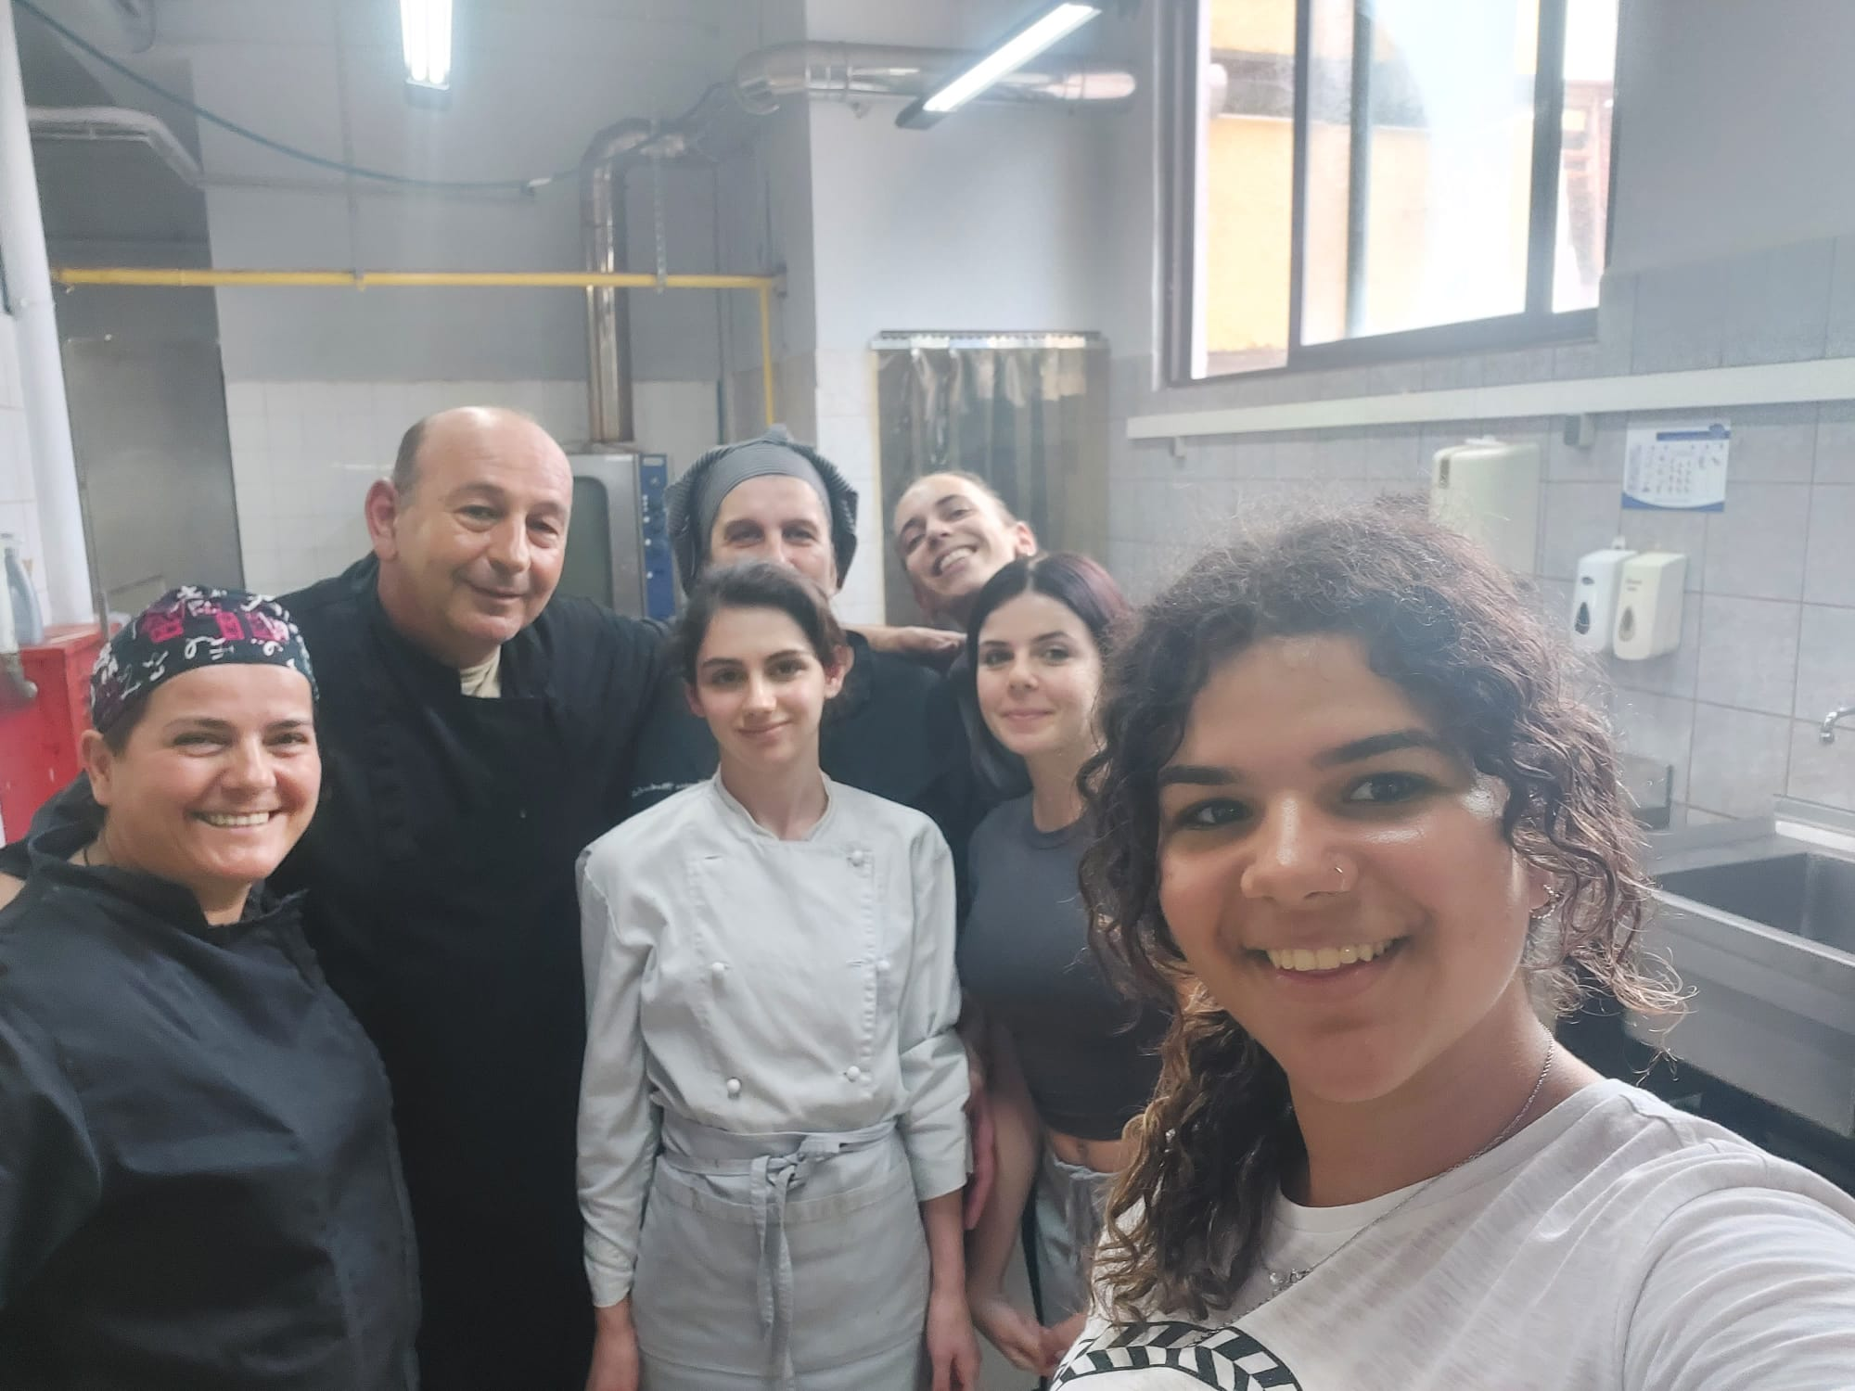

Slide 4
Christina Beach Hotel
Giada Vagni

Slide 5
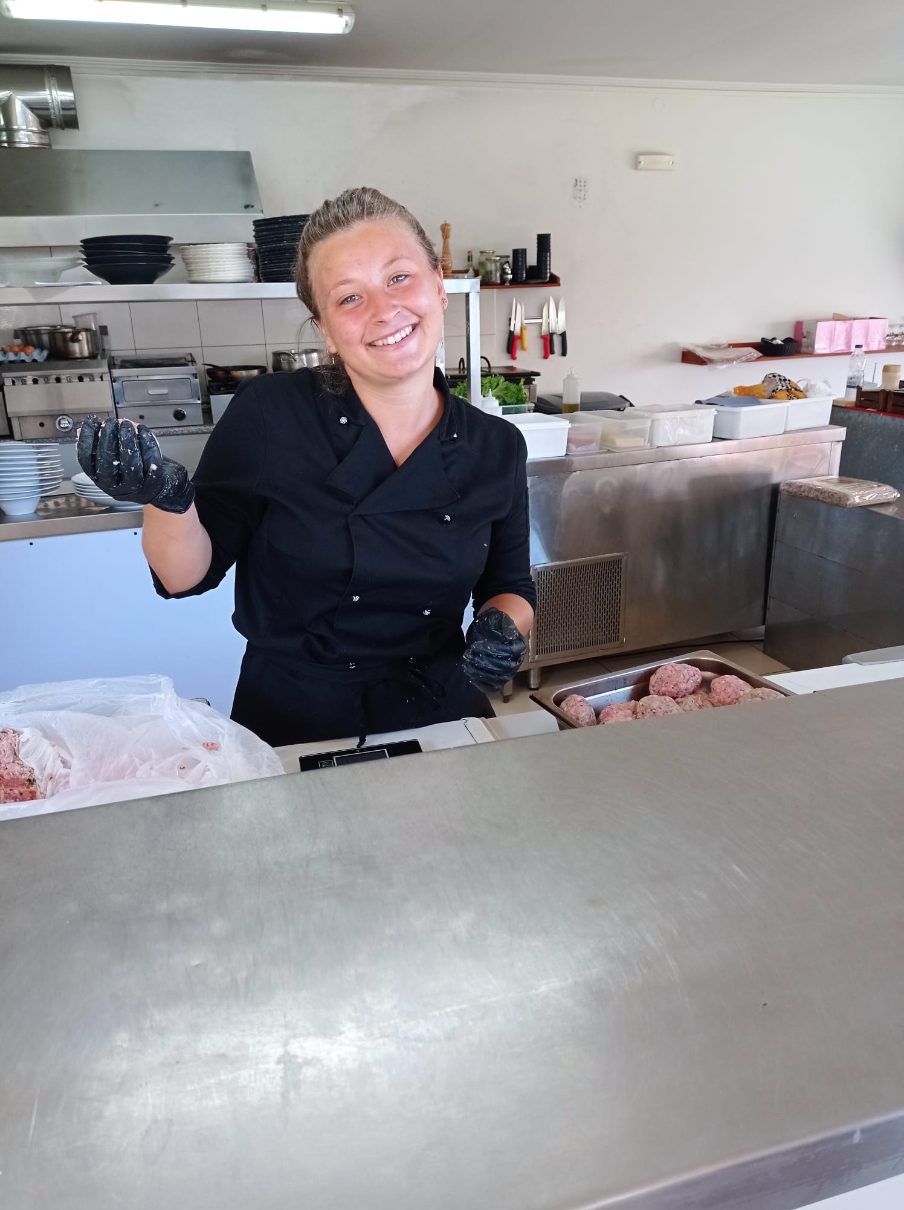
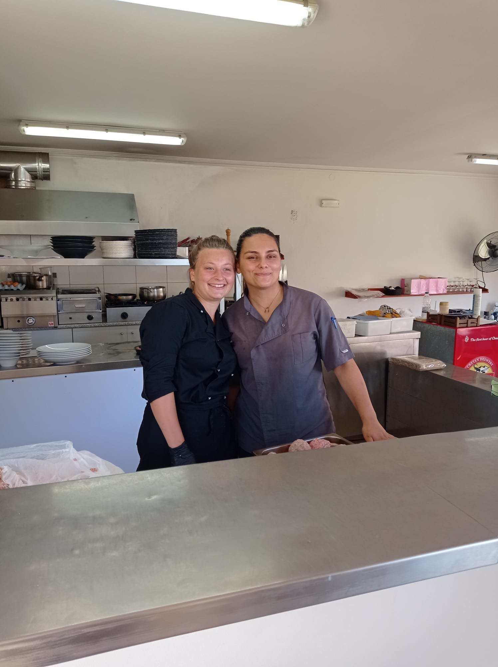

Slide 6
Sansal Boutique Hotel
Cristina Billardello
Leonardo Castaldo
Mattias Ripan

Slide 7
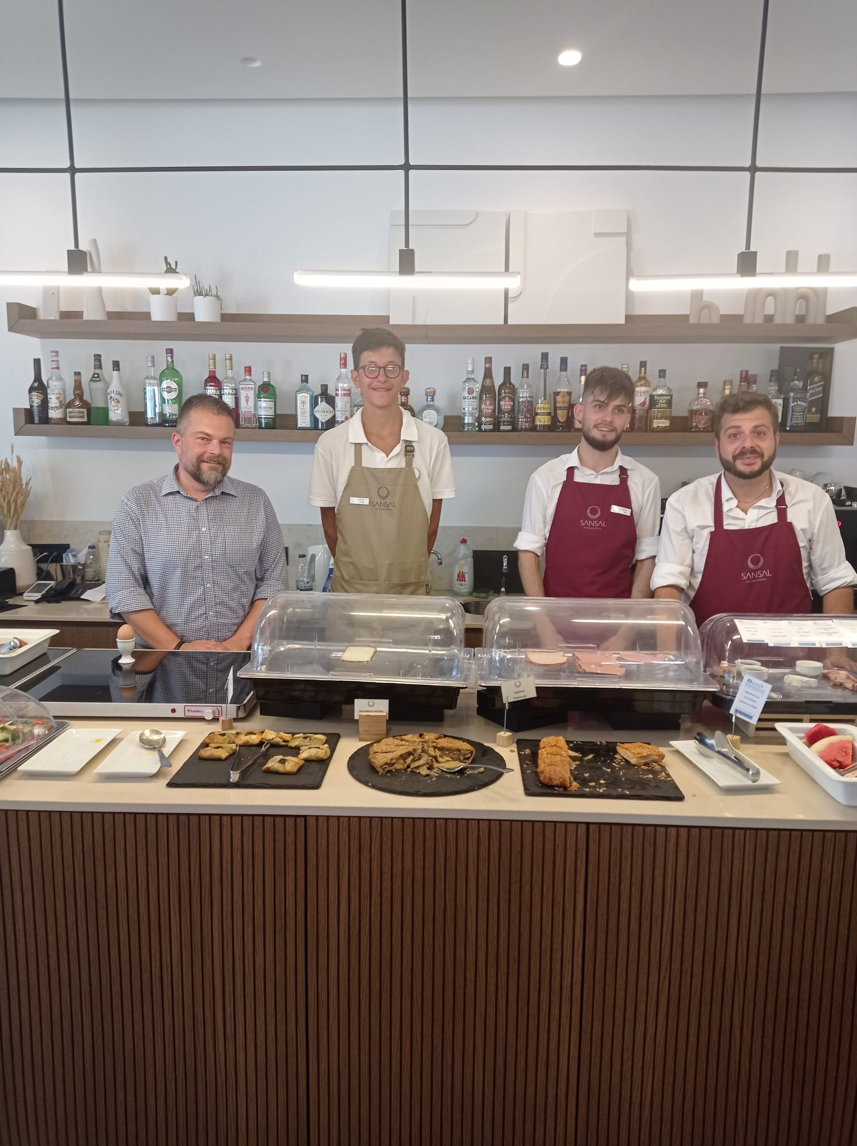
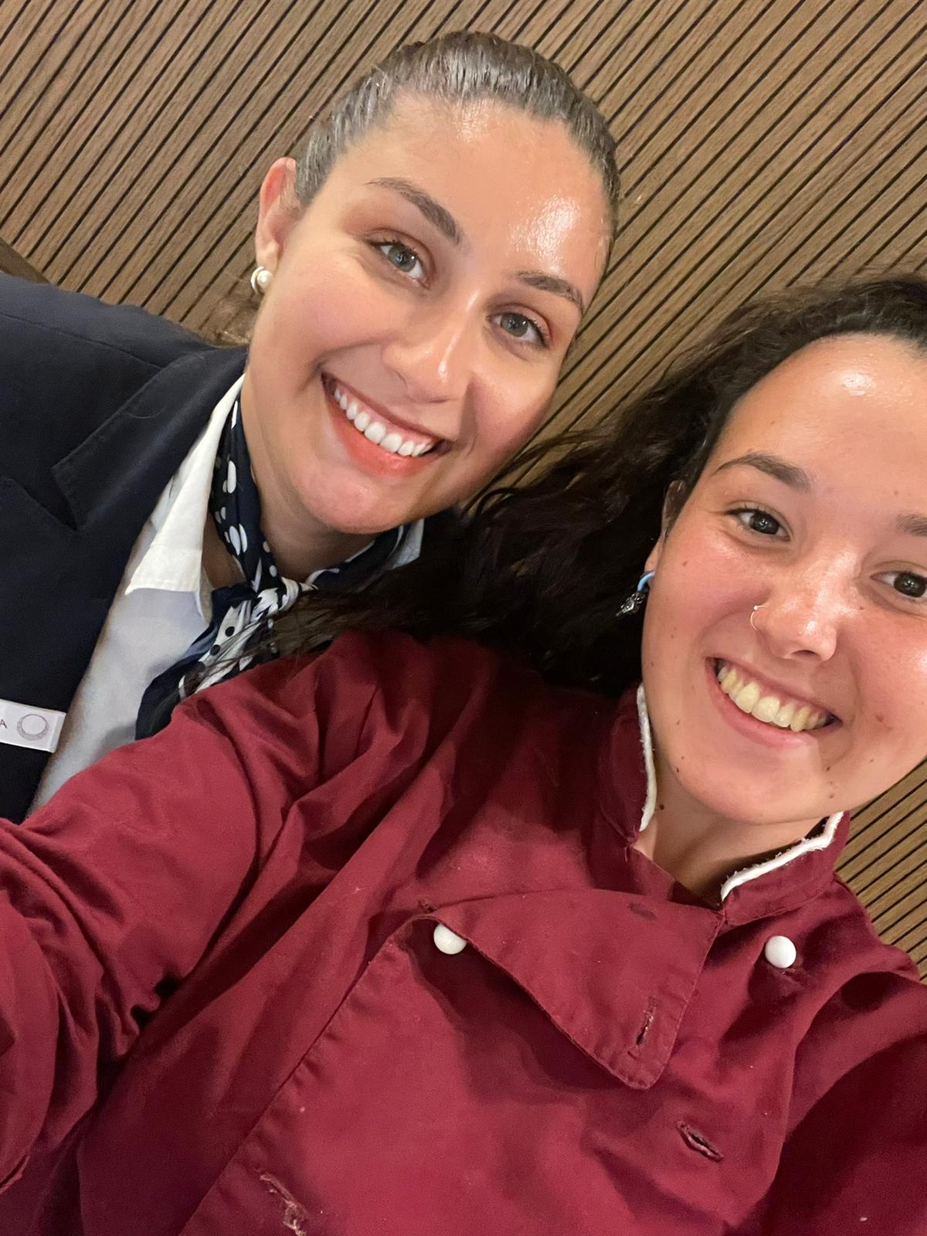
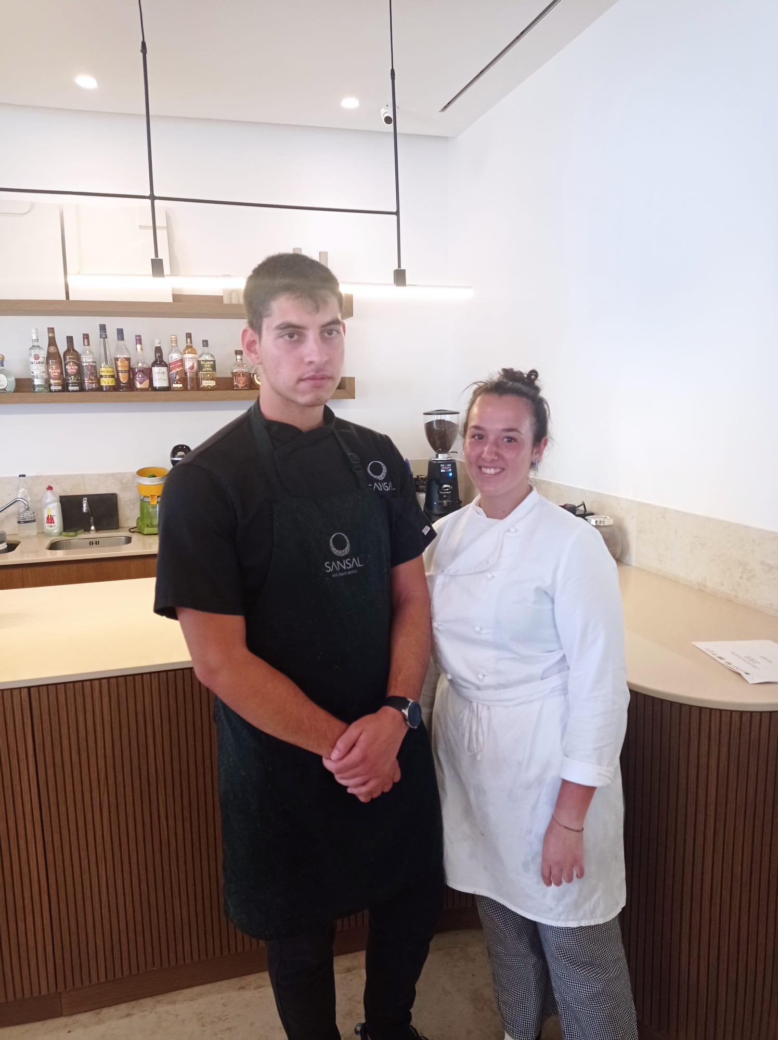

Slide 8
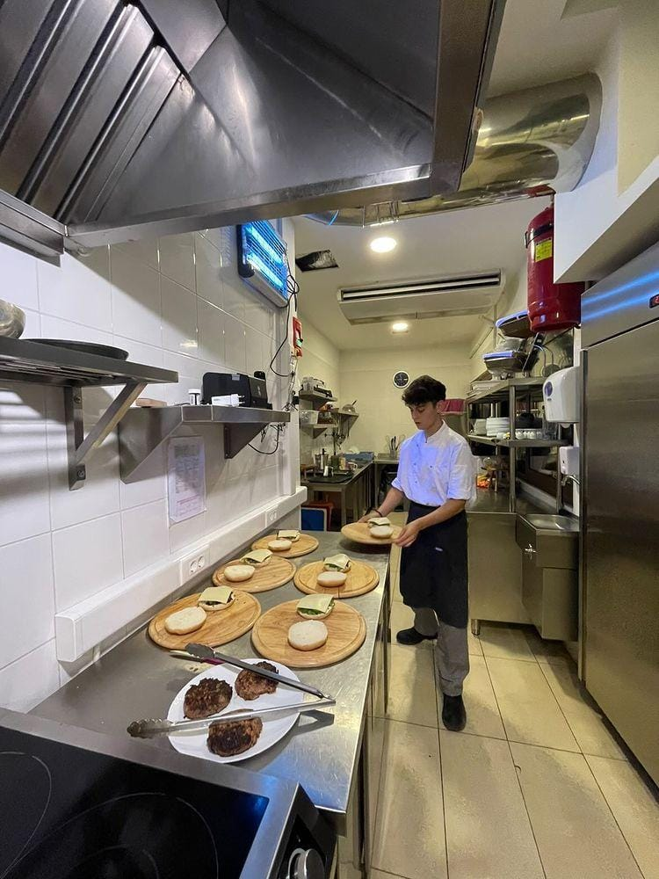
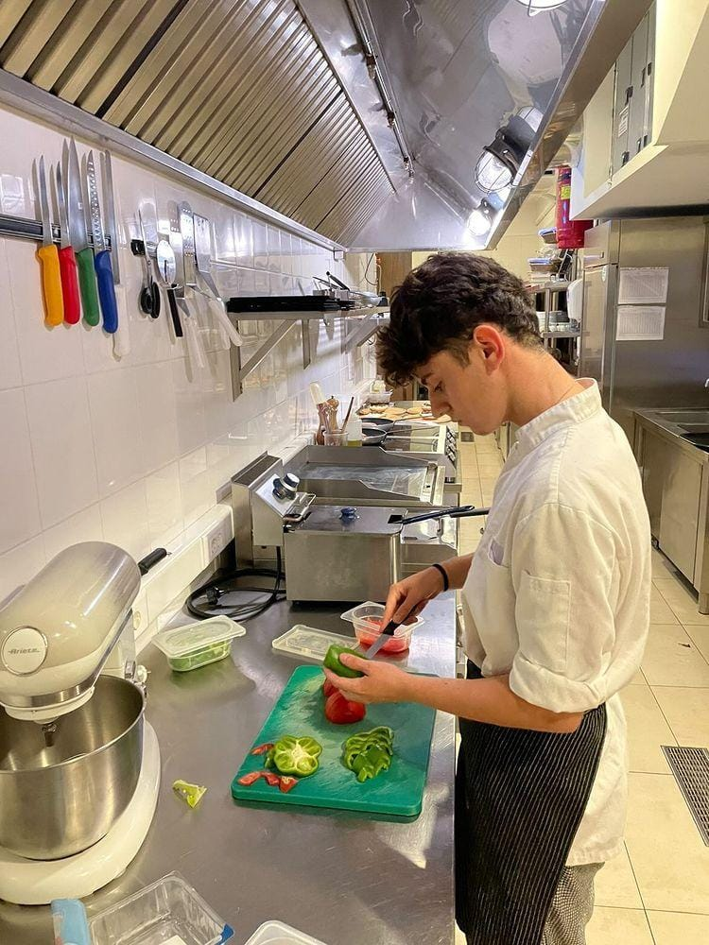

Slide 9
Leftos Panorama Hotel
Ilaria Cerri
Zsuzsanna Chereji
Manuel Colella
Emanuele De Flavia

Slide 10
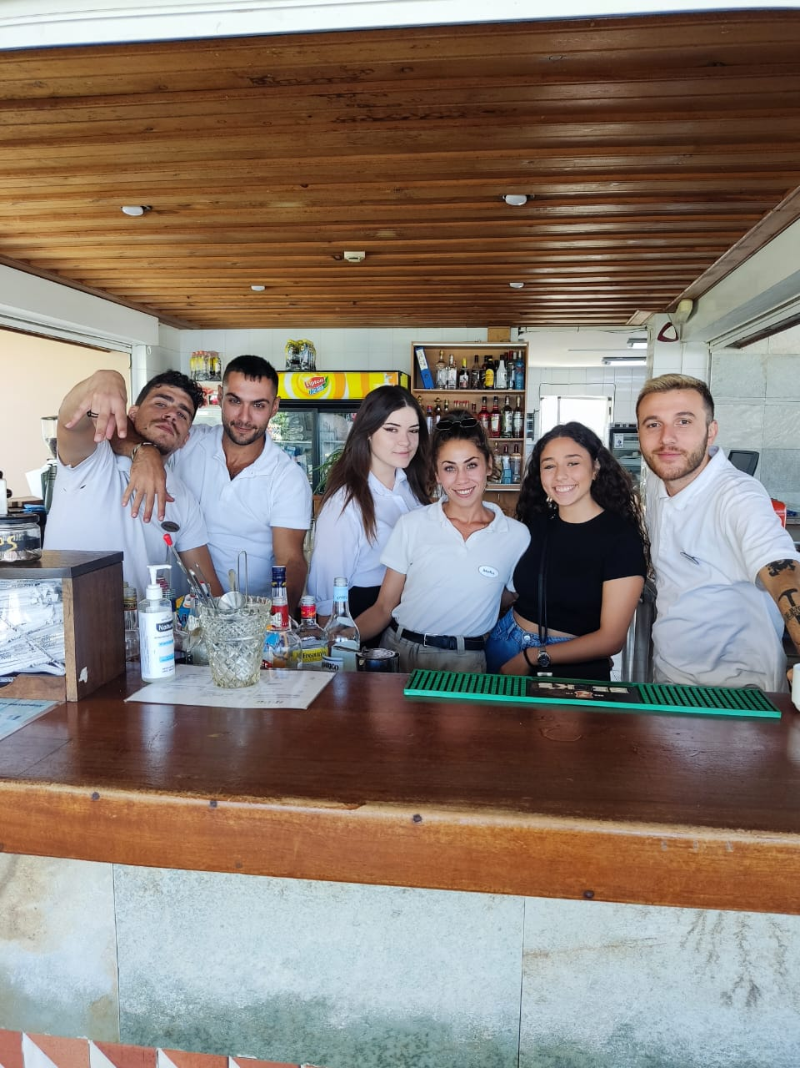
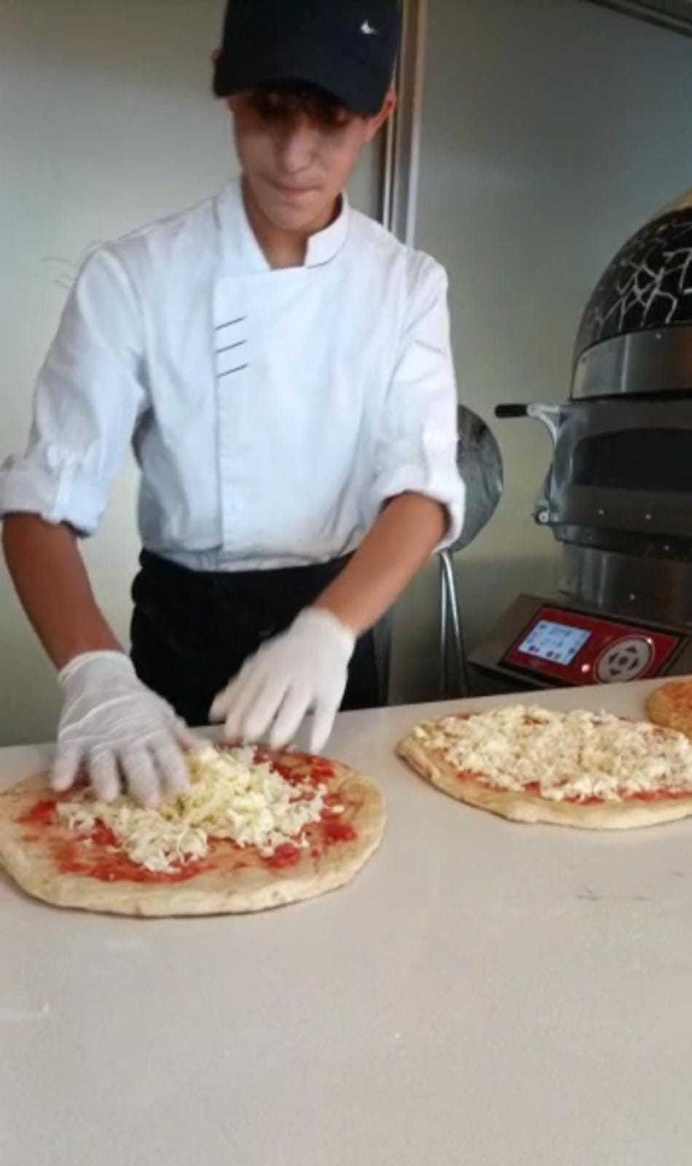
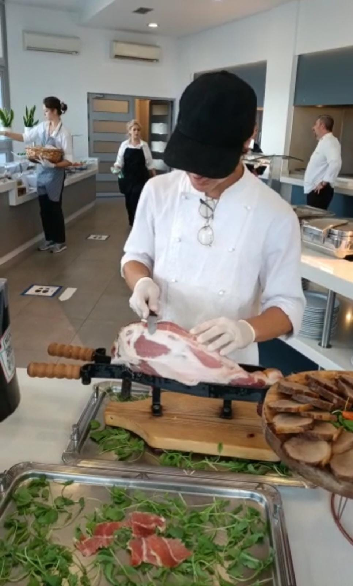

Slide 11
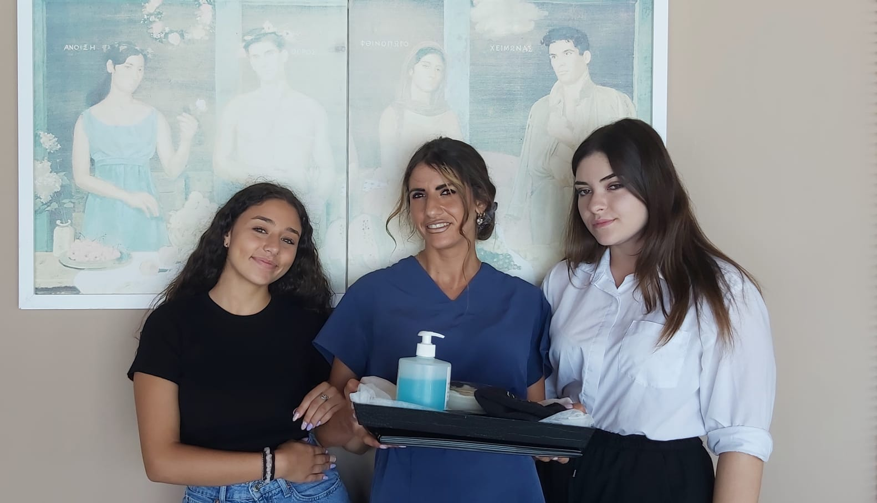
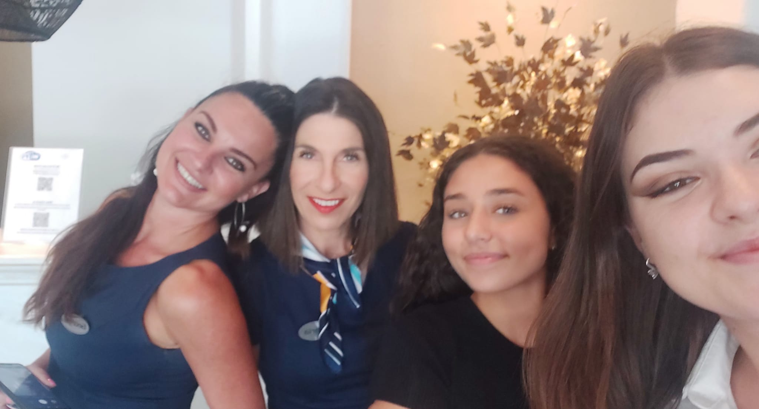
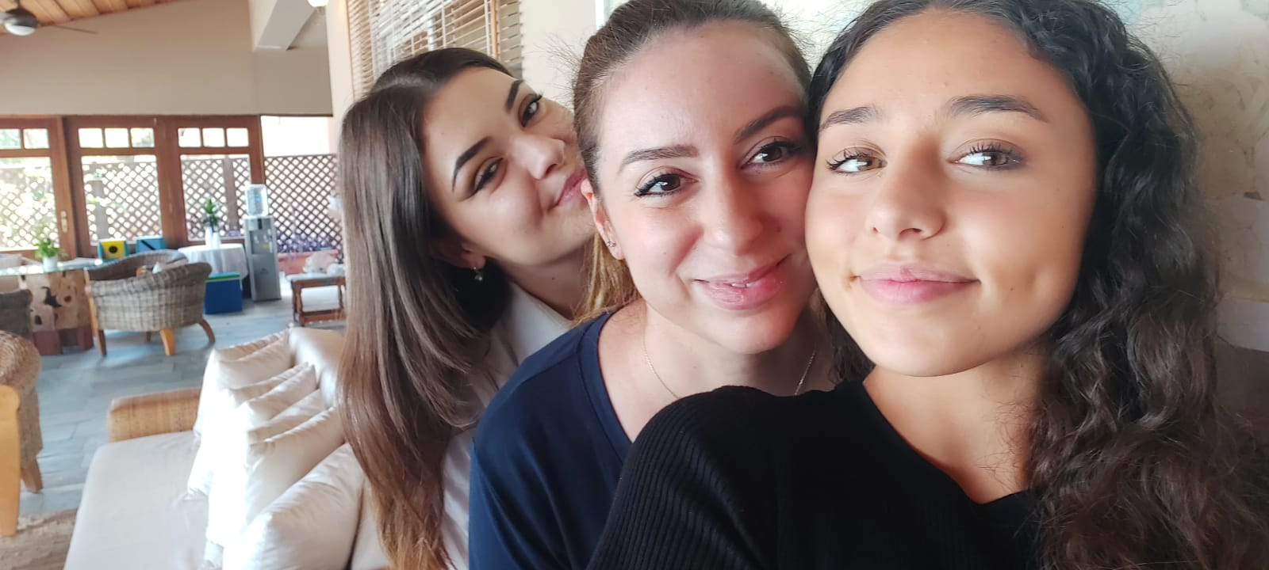

Slide 12
Althea Village
Emiliano Calabrese
Riccardo Chioccia
Mattia Fiori
Francesco Giorgianni
Alessia Guerrini
Giada Magro

Slide 13
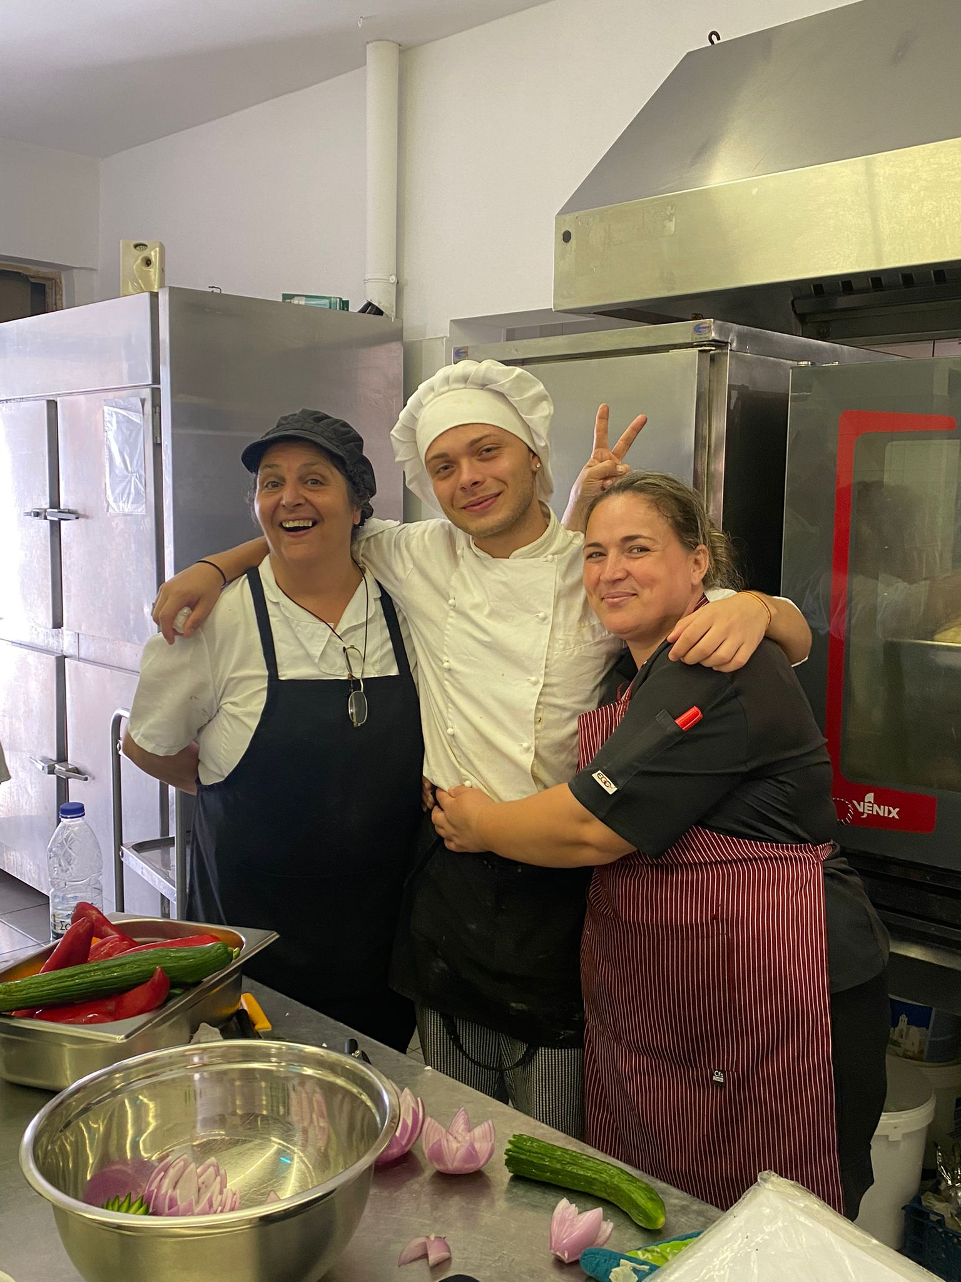
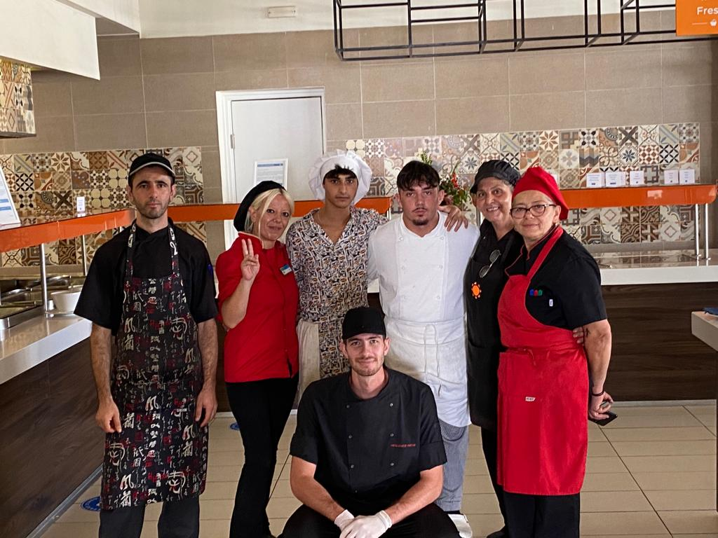

Slide 14
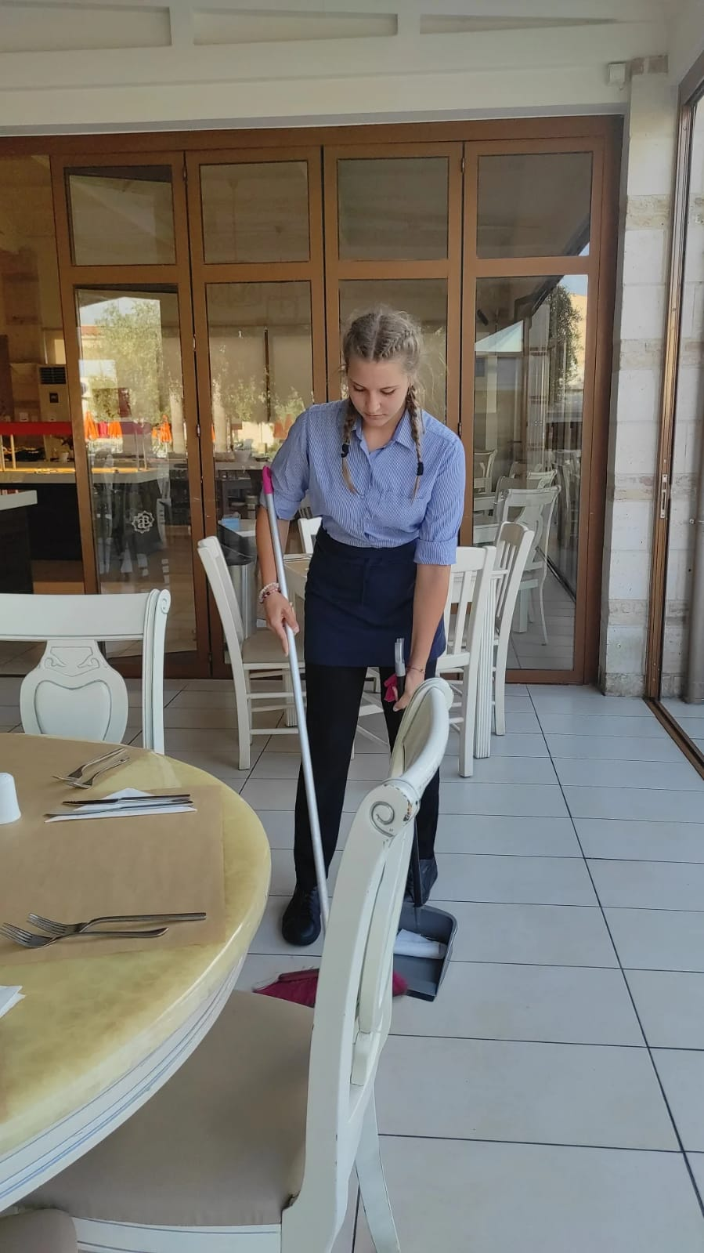
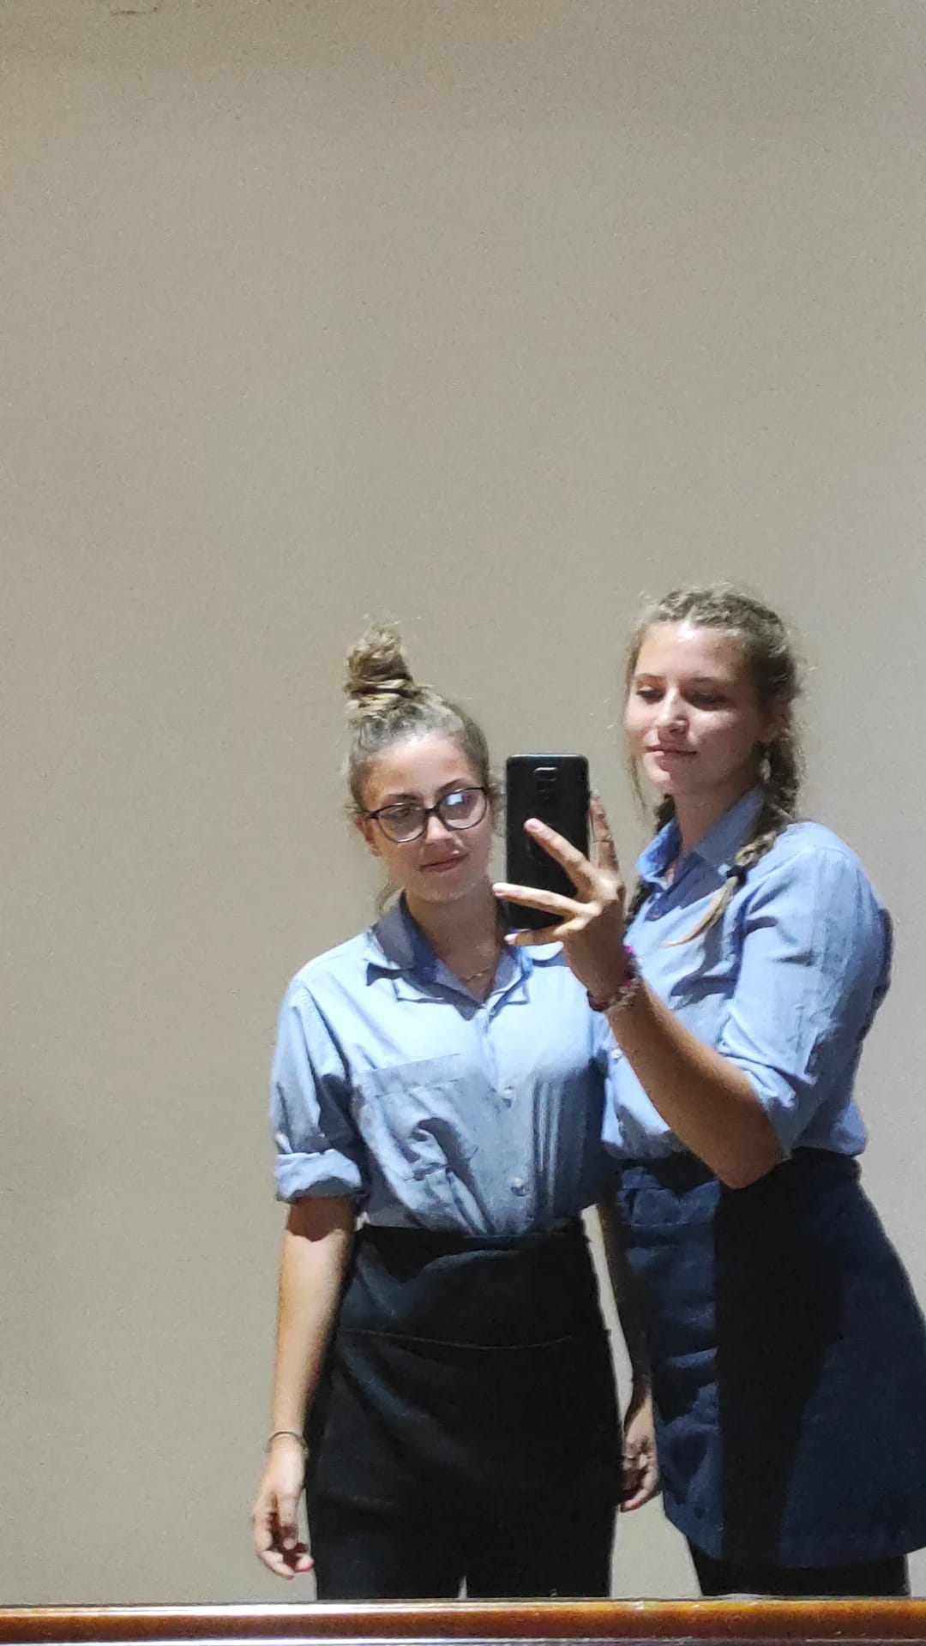
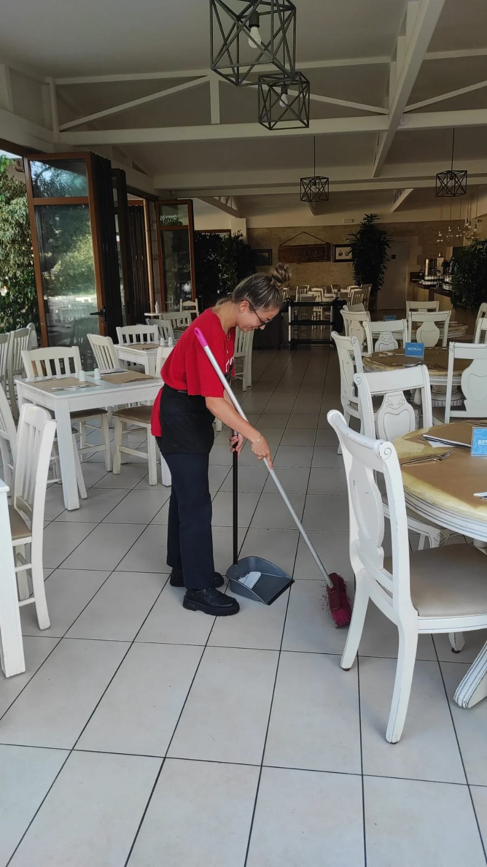

Slide 15
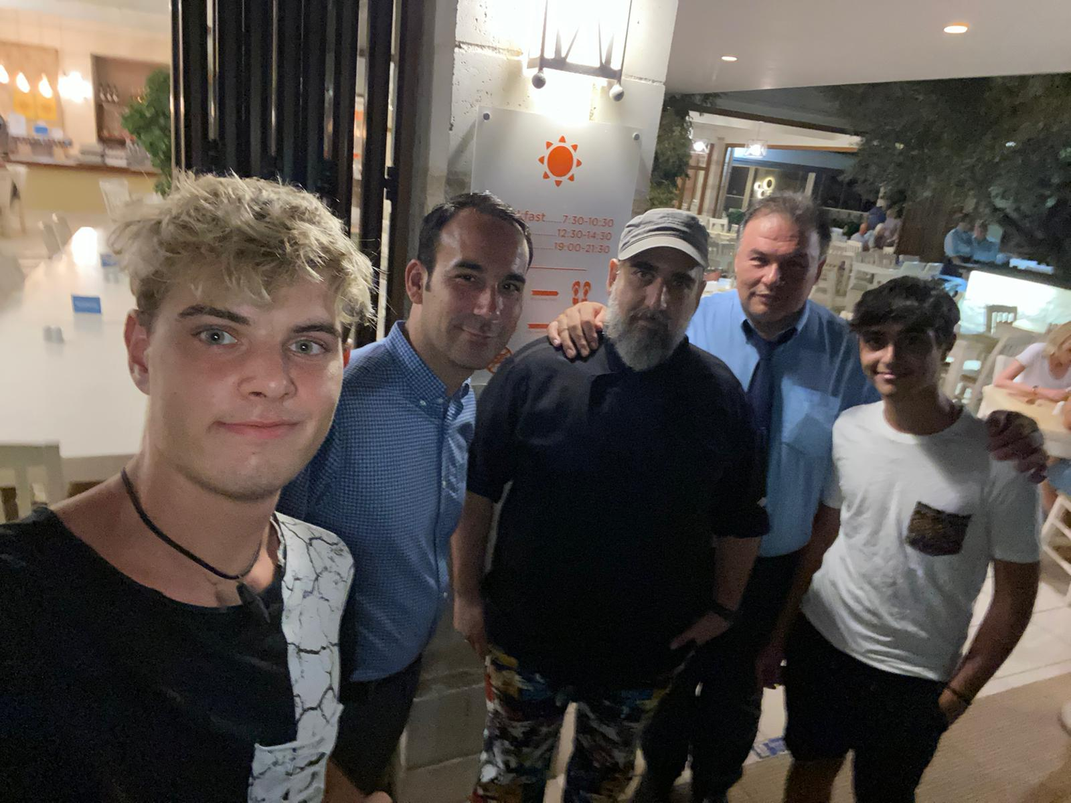
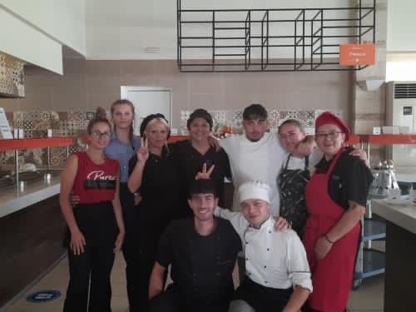

Slide 16
Helios Hotel
Aurora Amadio

Slide 17
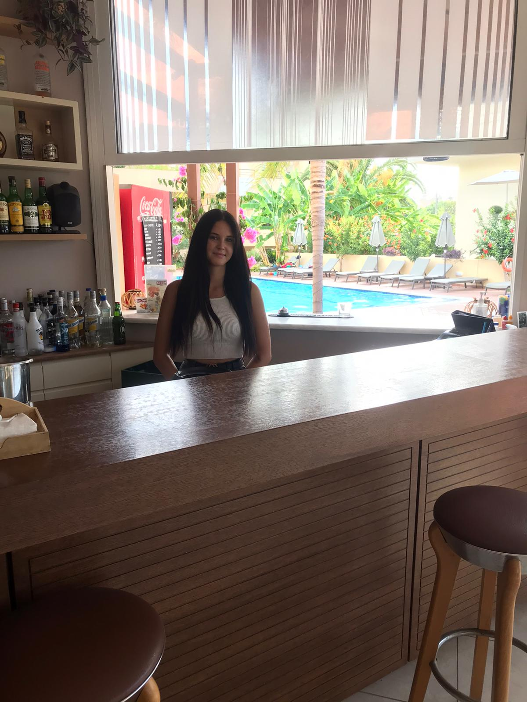
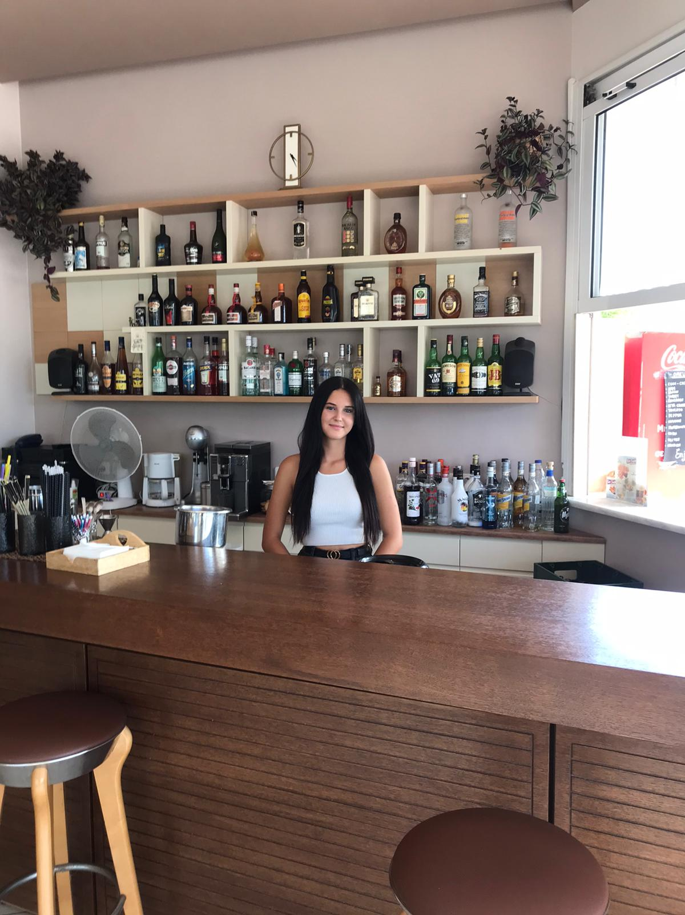

Slide 18
Playa Paraiso Falassarna
Giulia Botti
Mario Anton
Giada Carlaccini
Maria Angela Iodice
Eduard Loghin
Alessio Longobardi
Marcello Montanari
Asia Rosignoli

Slide 19
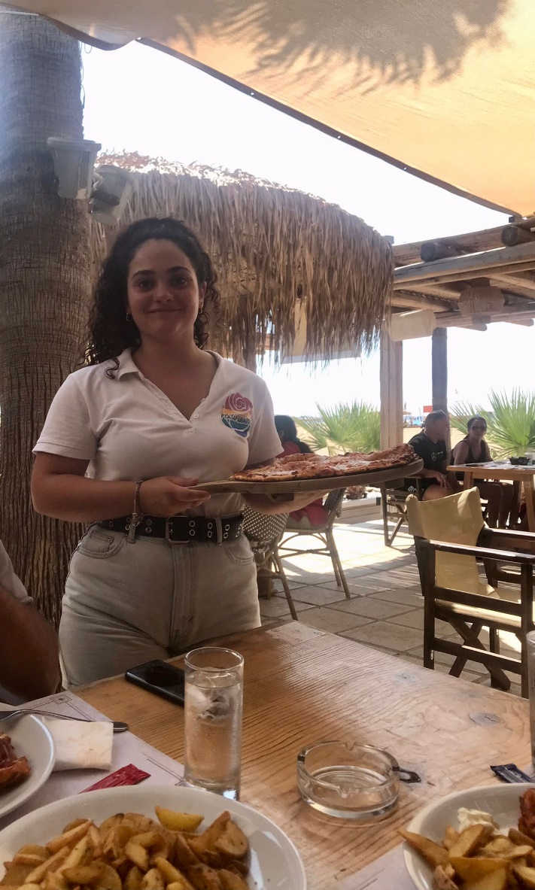
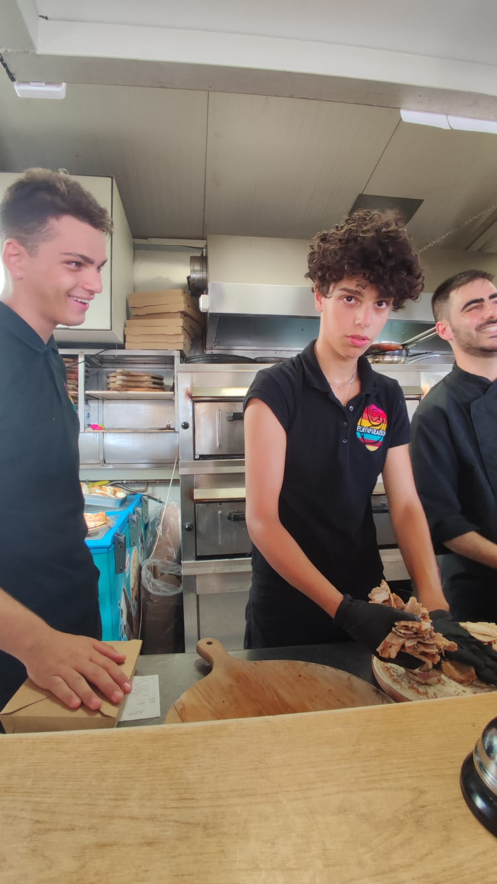
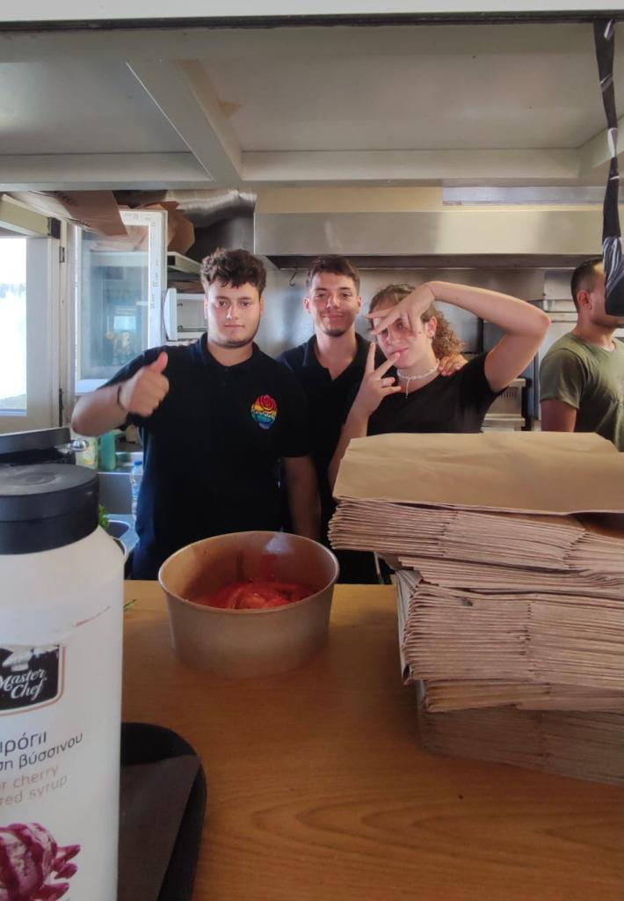
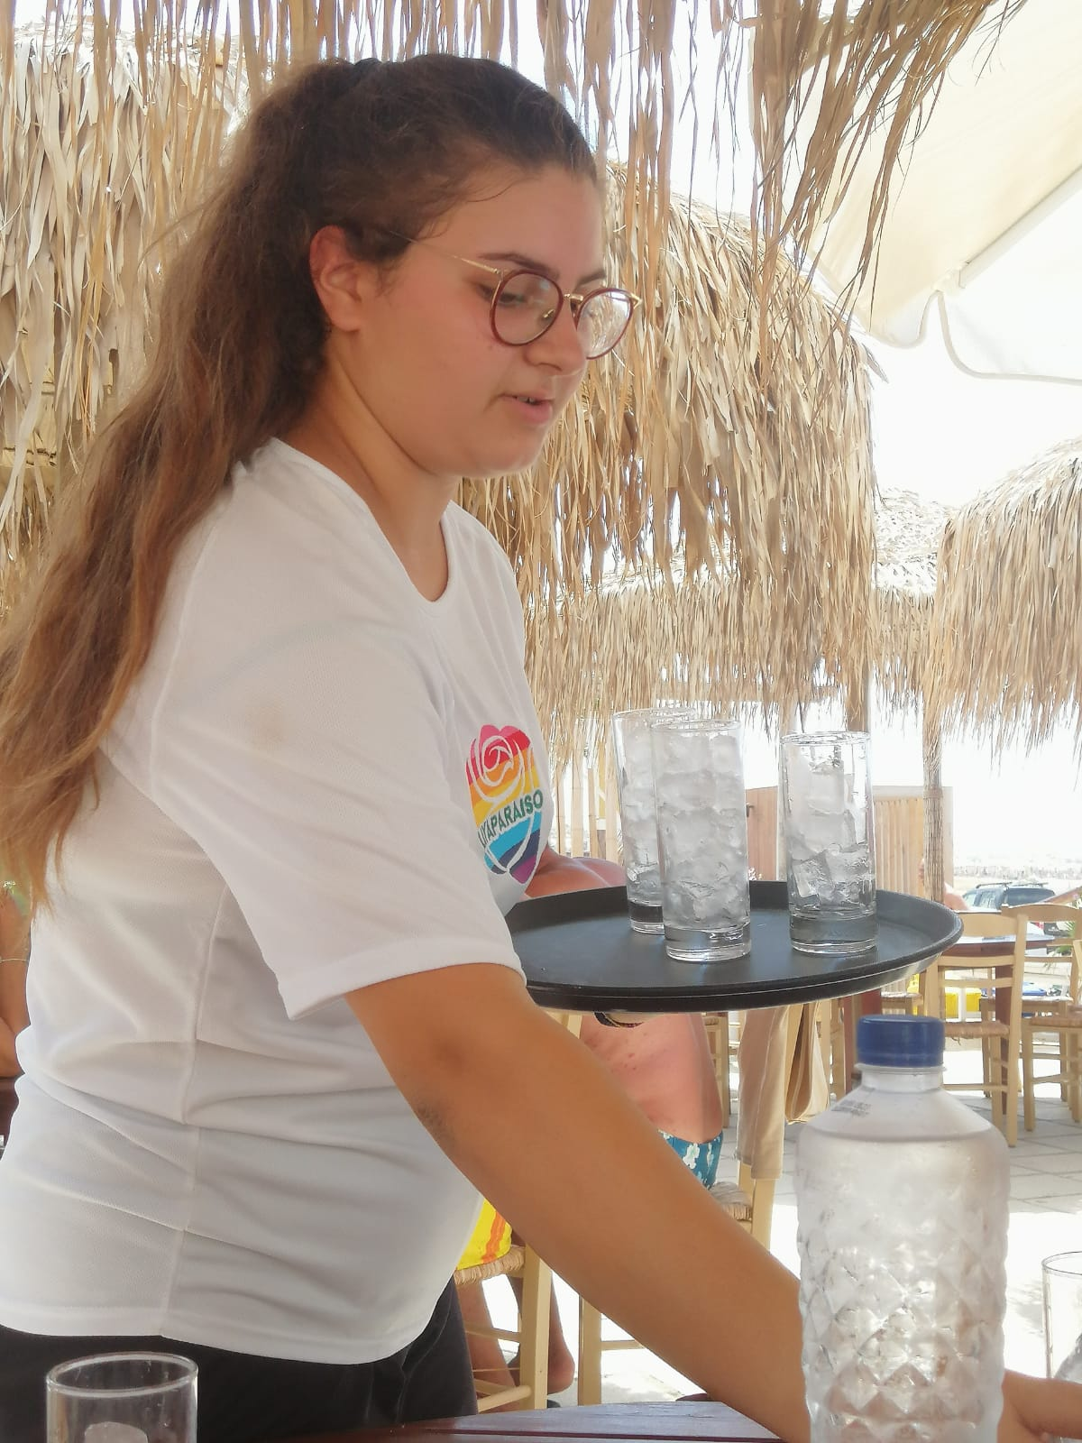

Slide 20
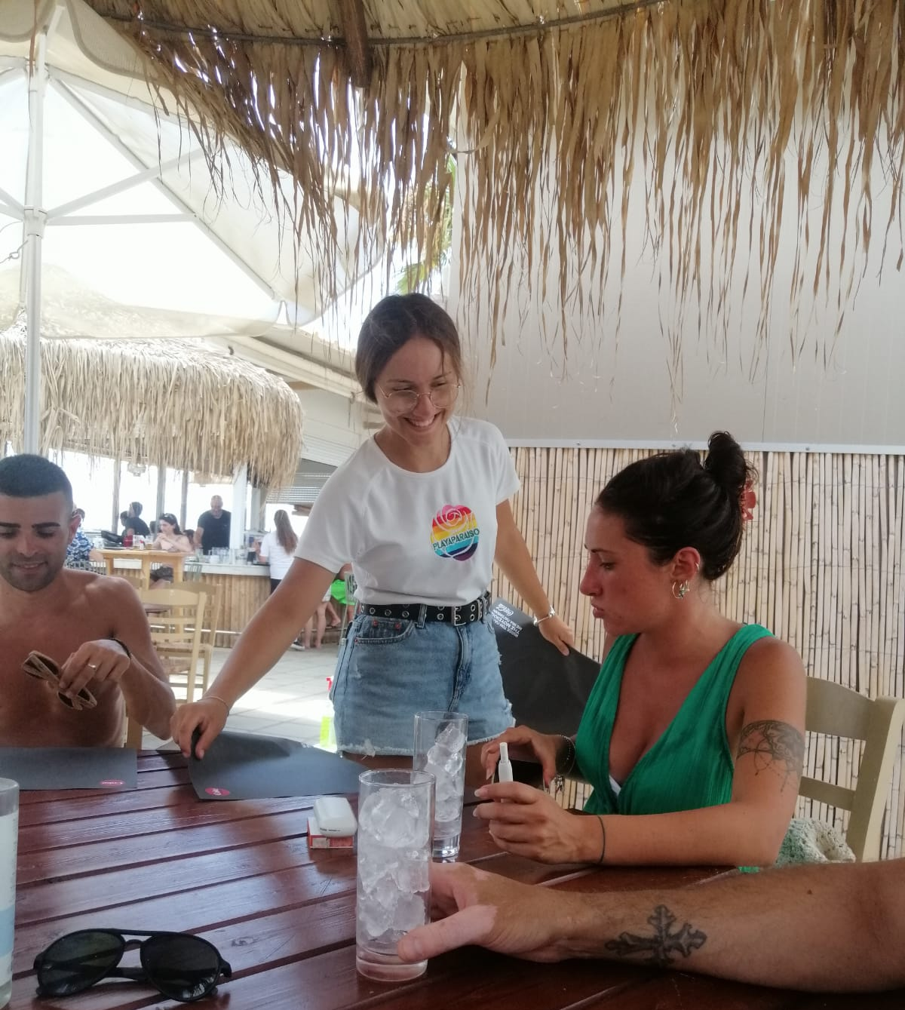
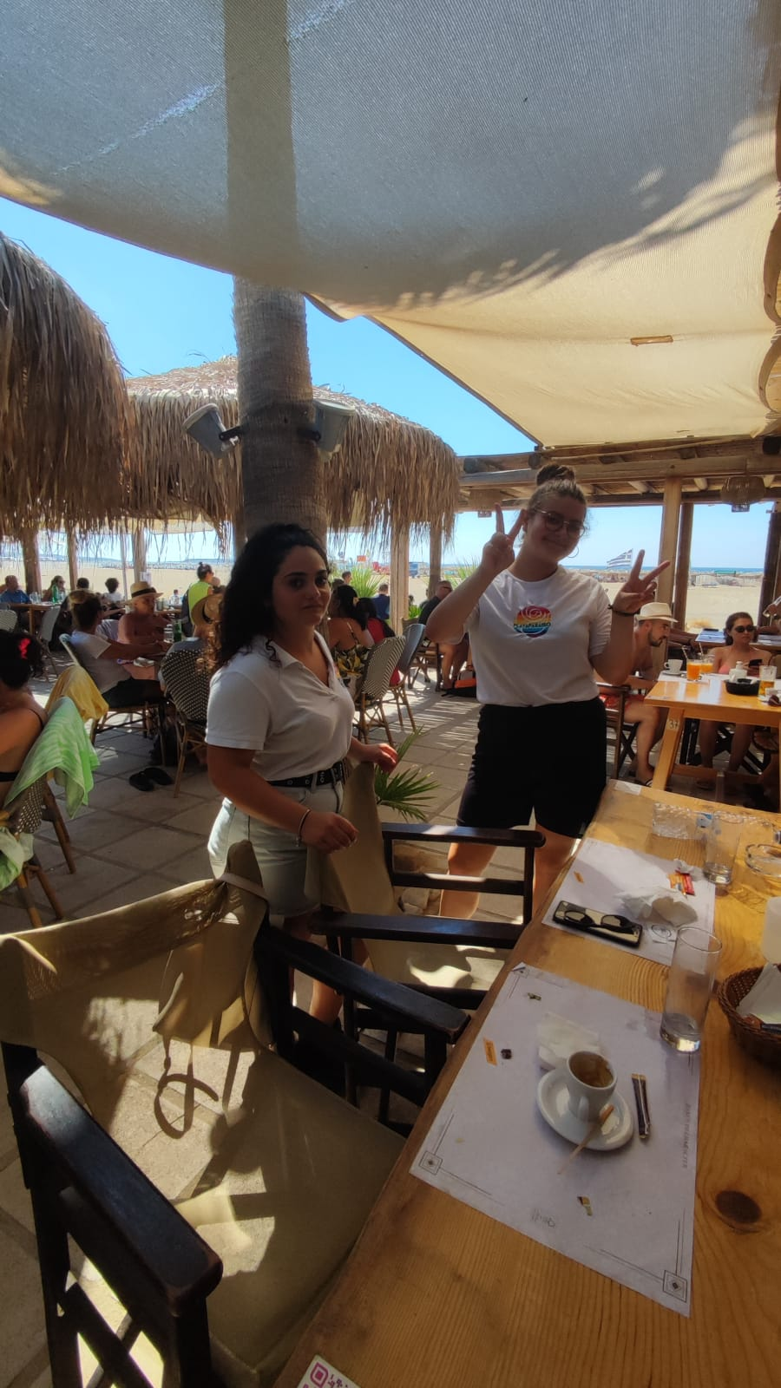
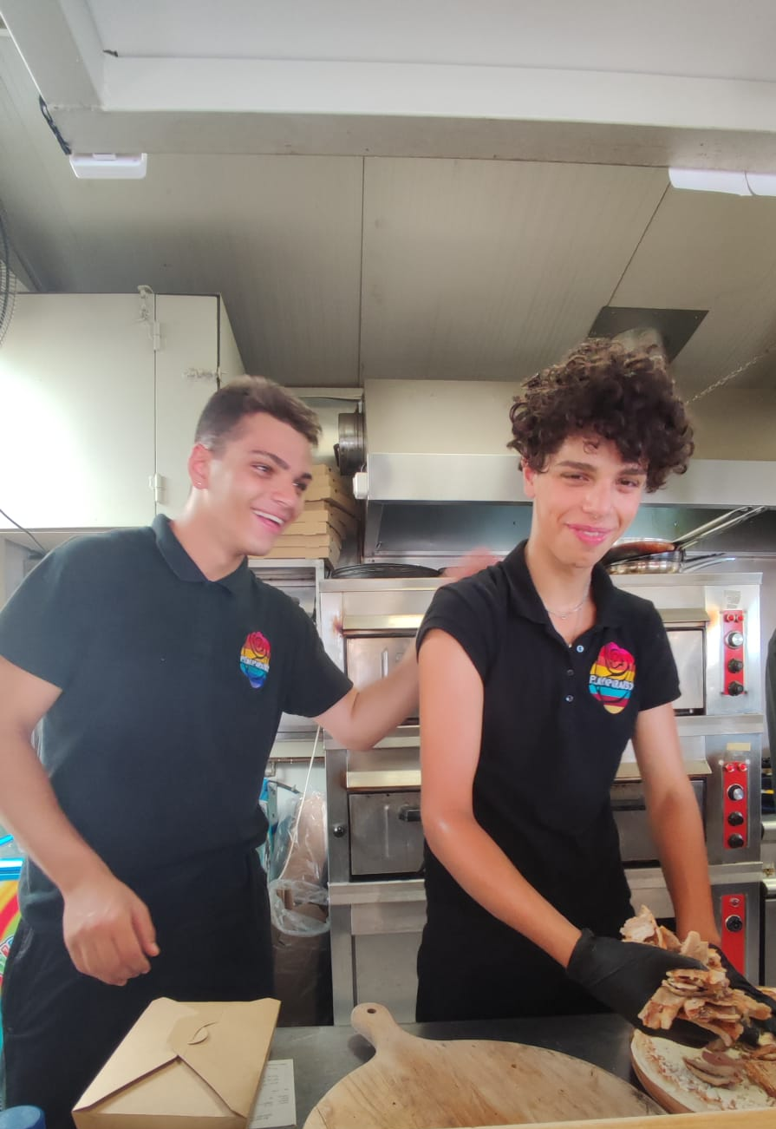

Slide 21
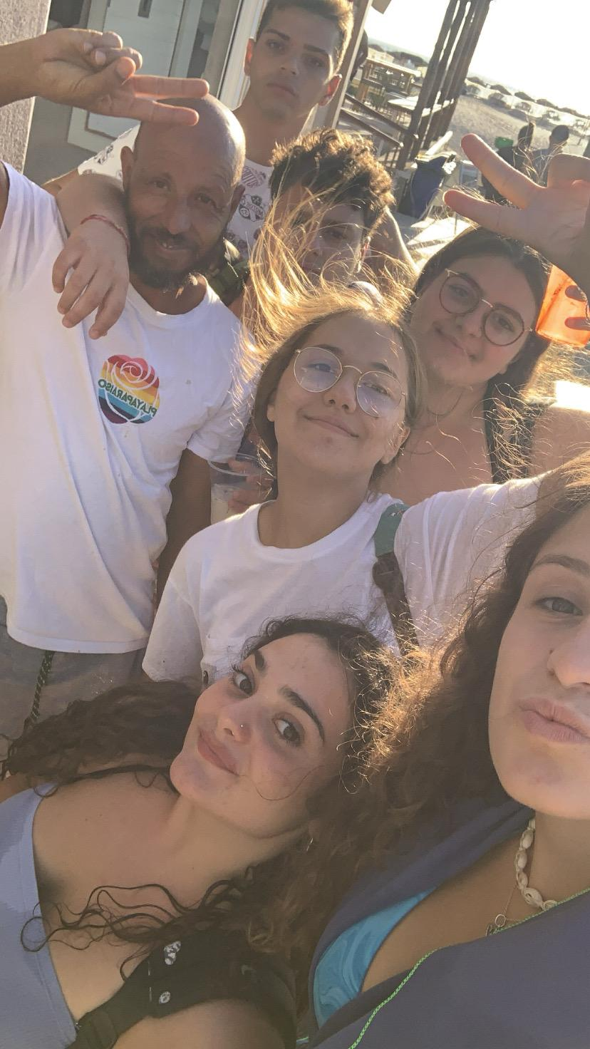

Slide 22
Halepa Hotel
Angelica Lattanzi

Slide 23
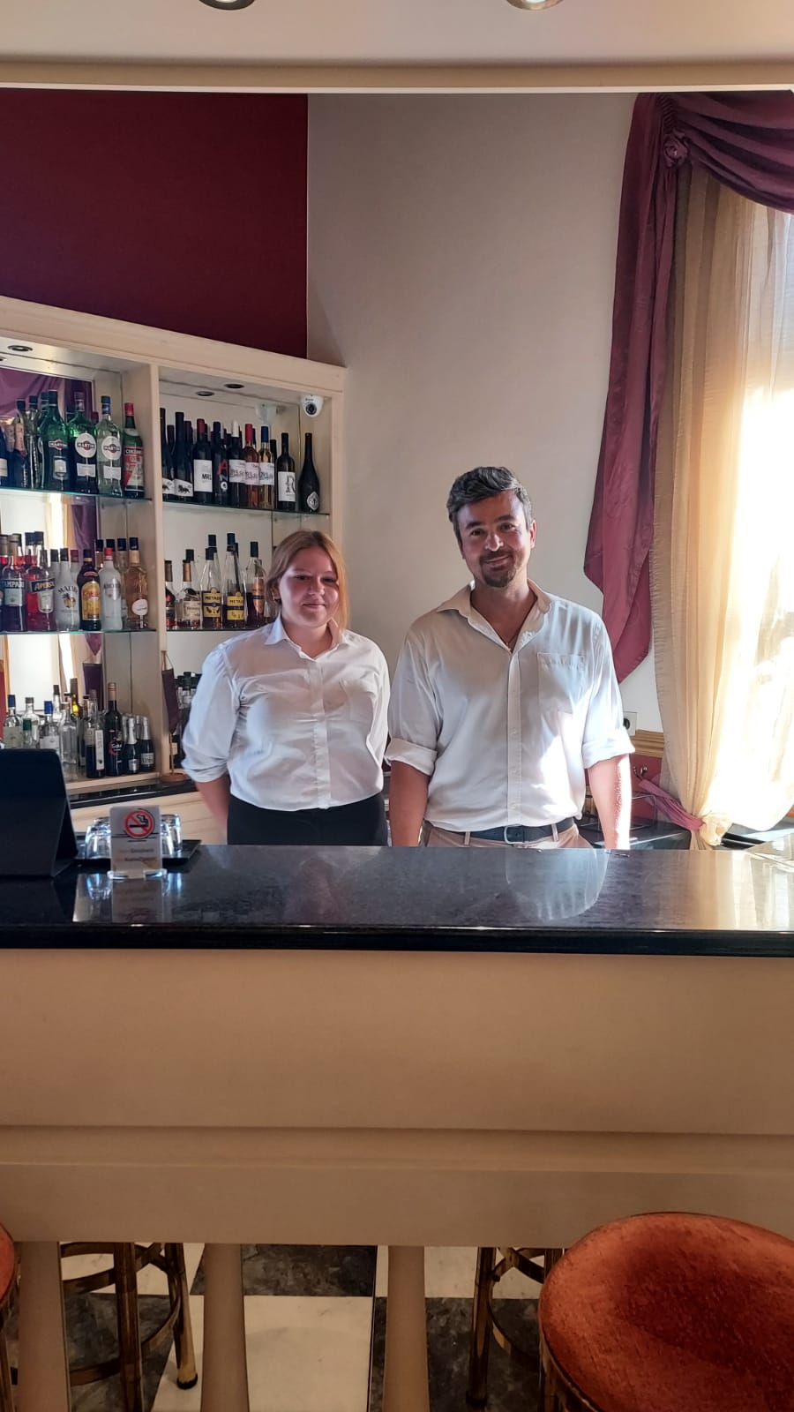

Slide 24
Dionyssos Village
Samuel Sacchetti
Davide Leone

Slide 25
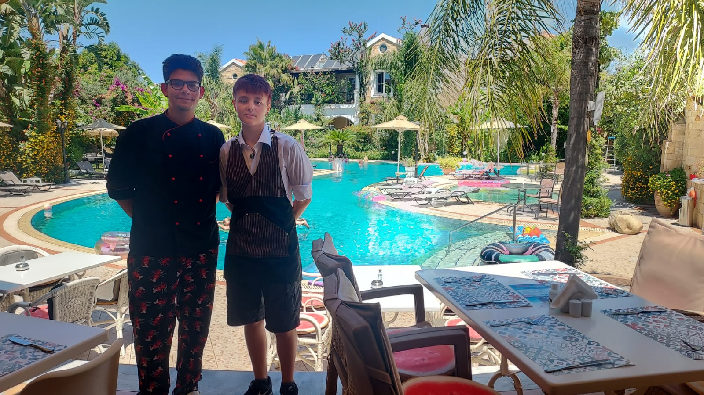

Slide 26
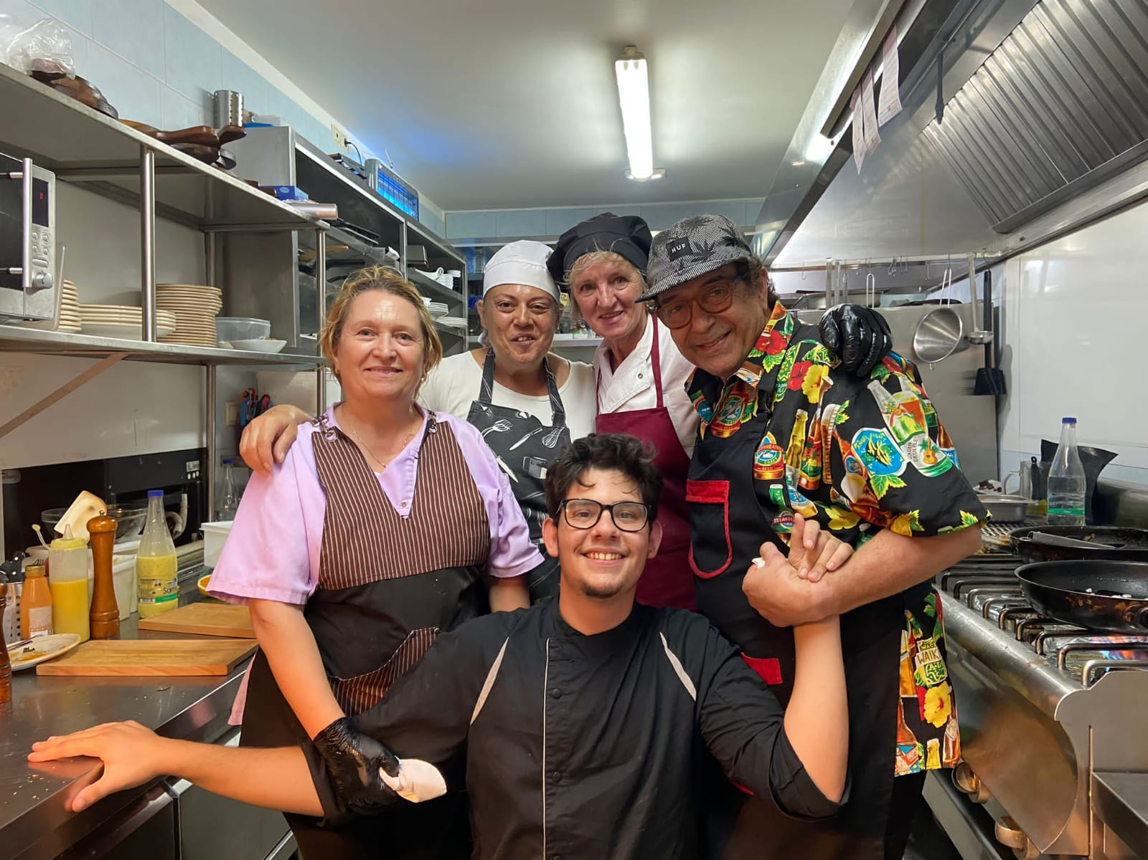
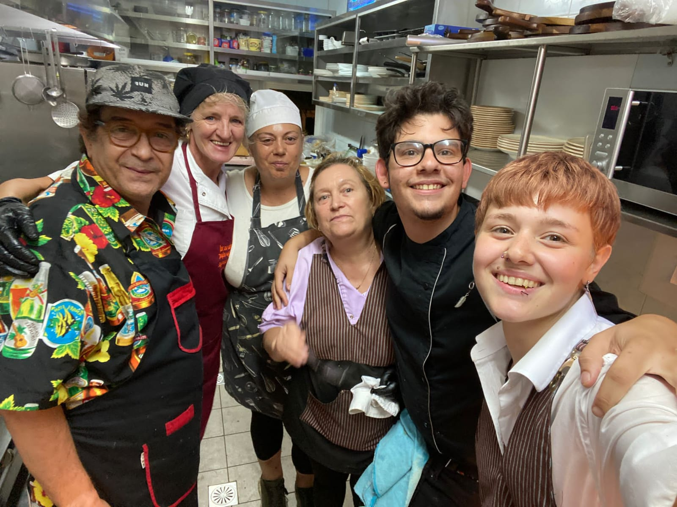

Slide 27
La Mer Resort & Spa
Matteo Troiani
Emanuele Ferrera

Slide 28
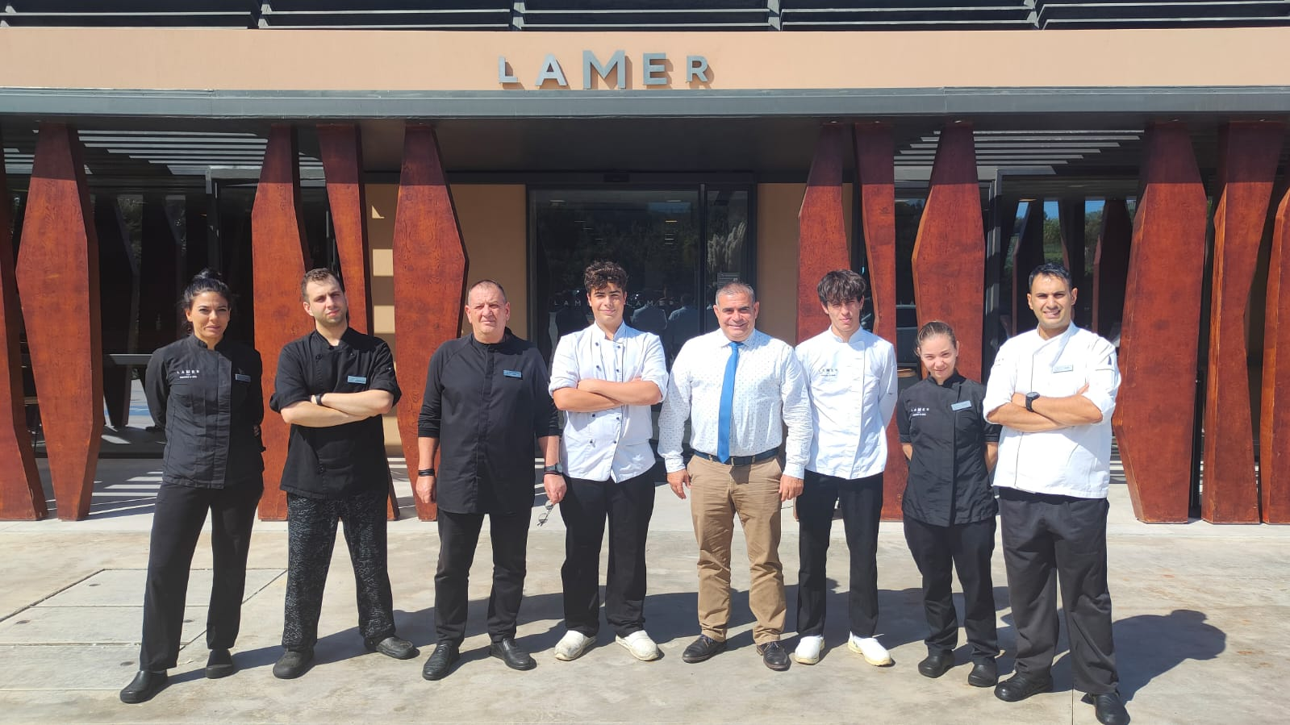

Slide 29
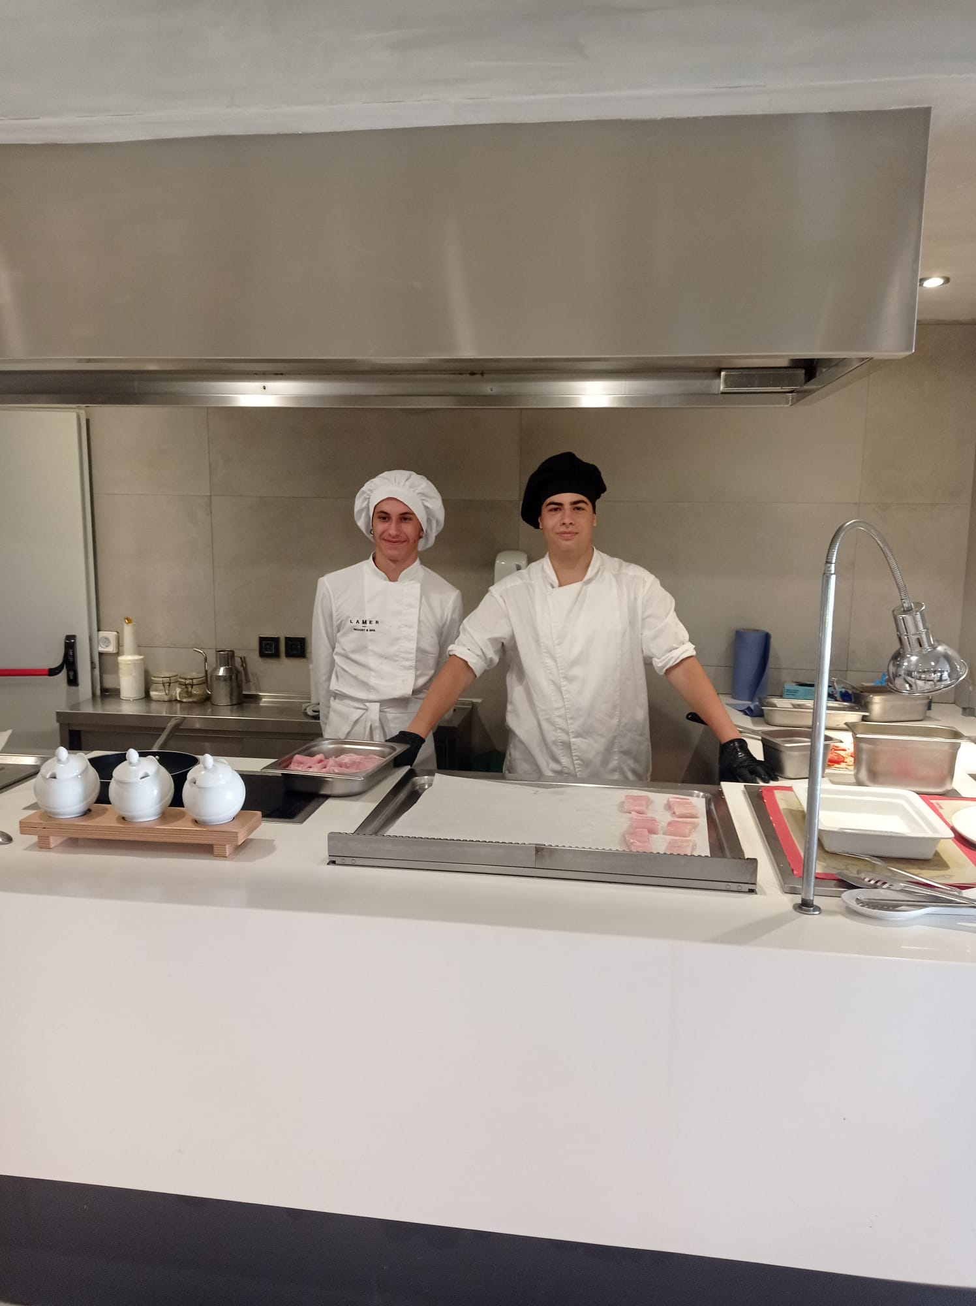

Slide 30
Zeus Village Resort
Piero Molino
Gaia Di Lodovico

Slide 31
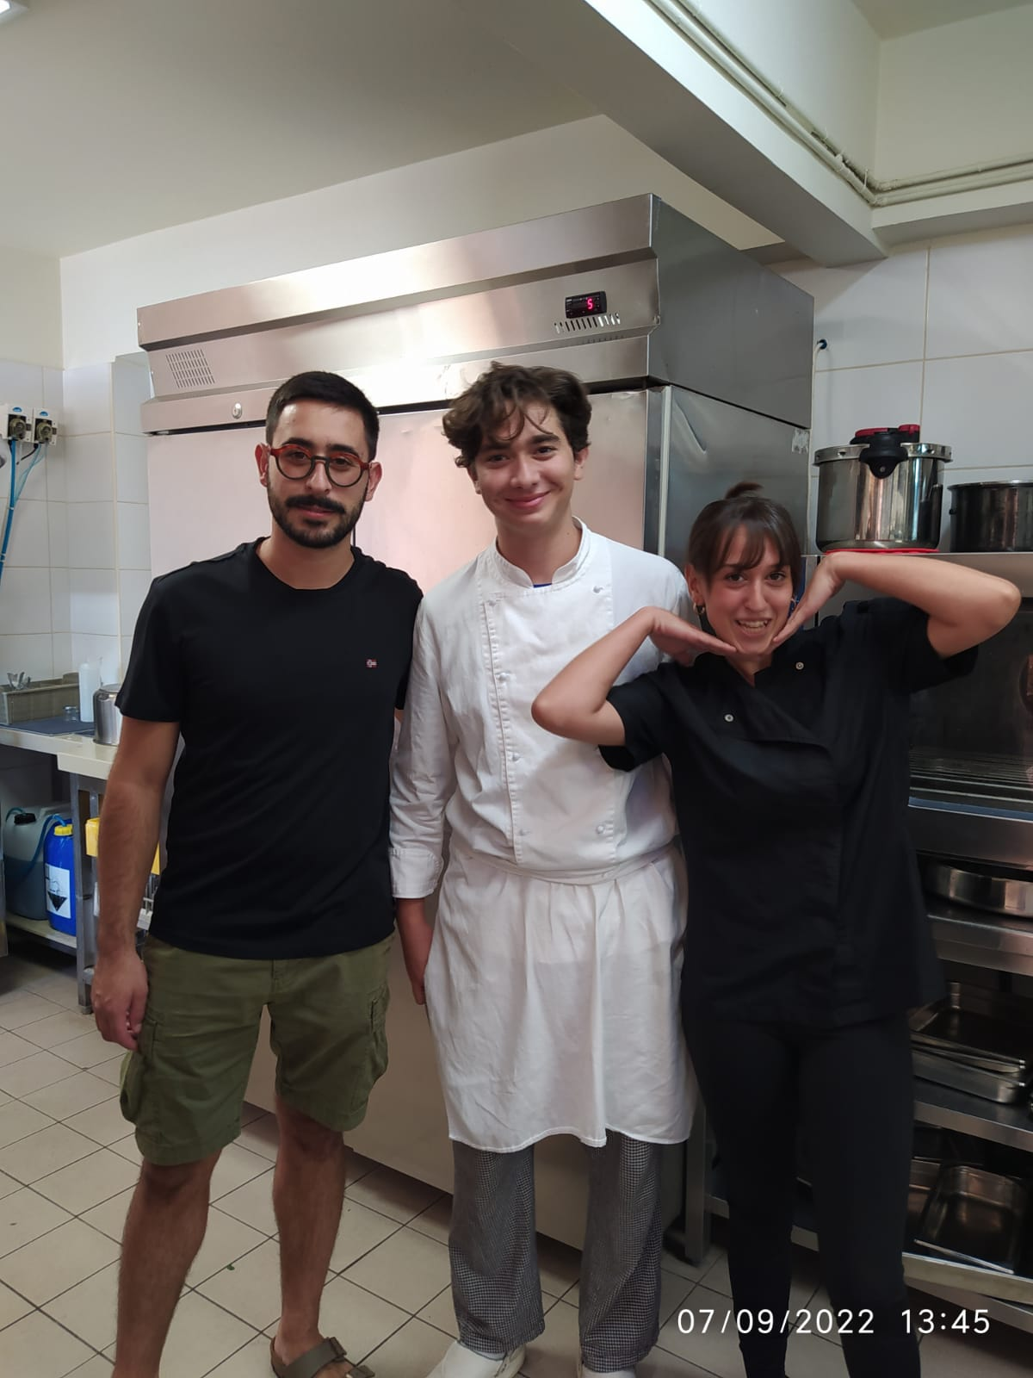
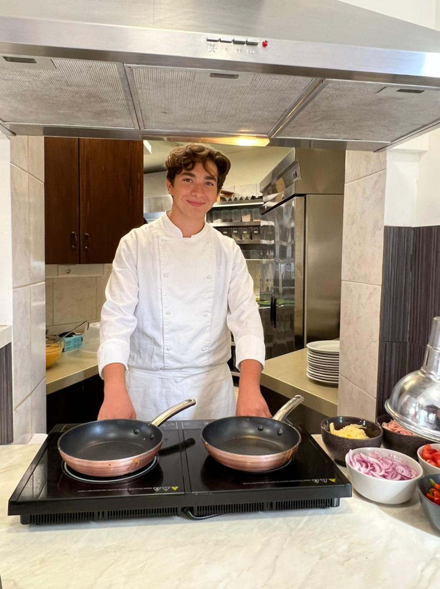

Slide 32
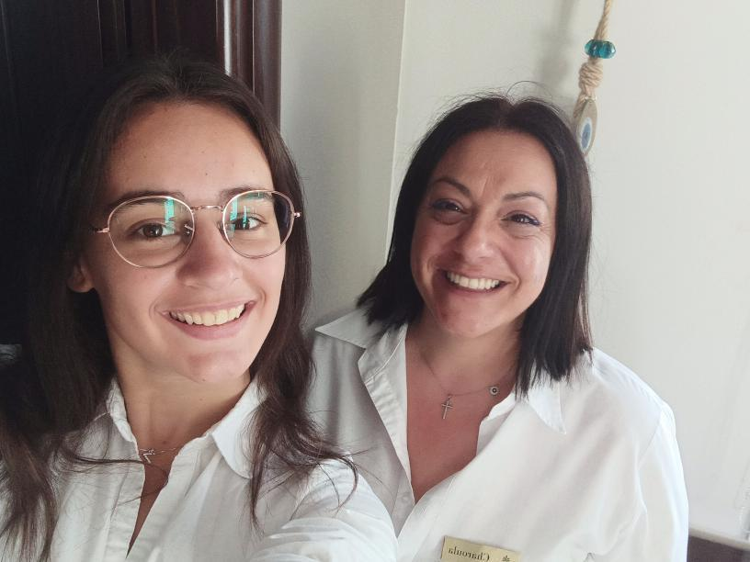

Slide 33
Hotel Stellina Village
Adriano Faticanti
Federico Micheli

Slide 34
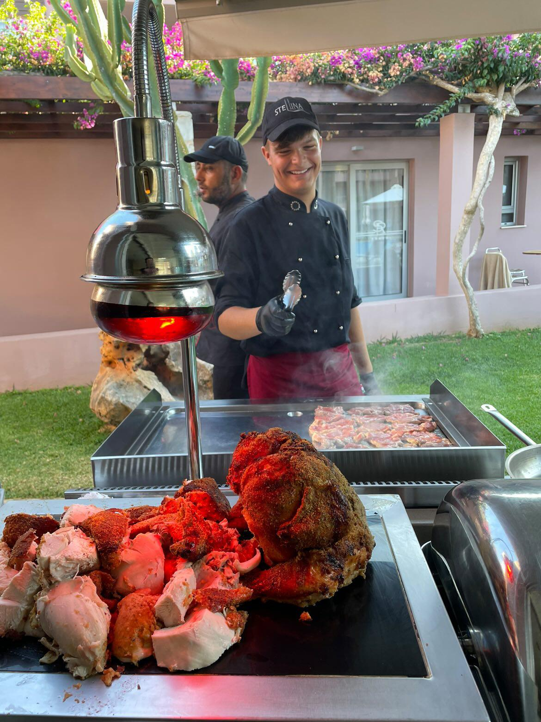
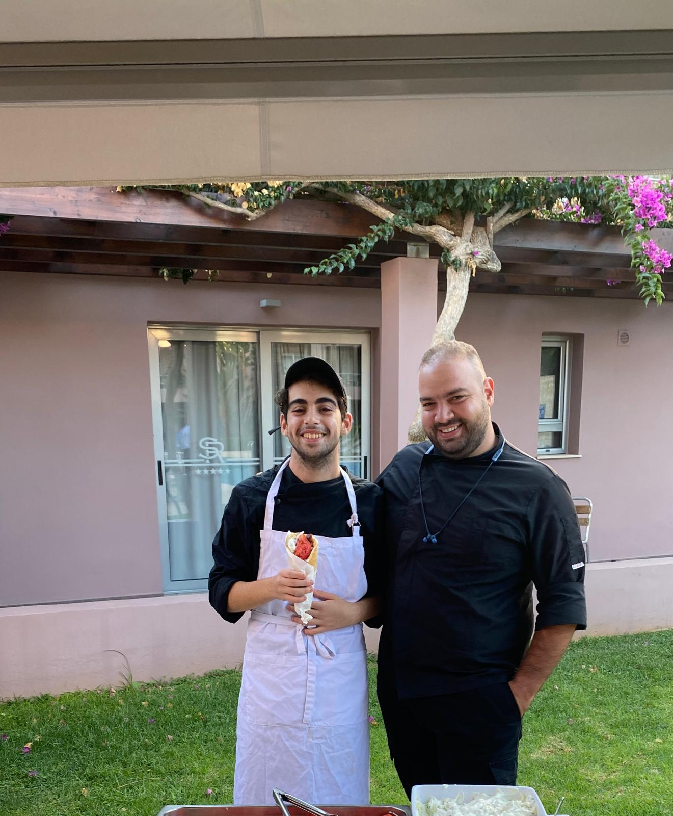

Slide 35
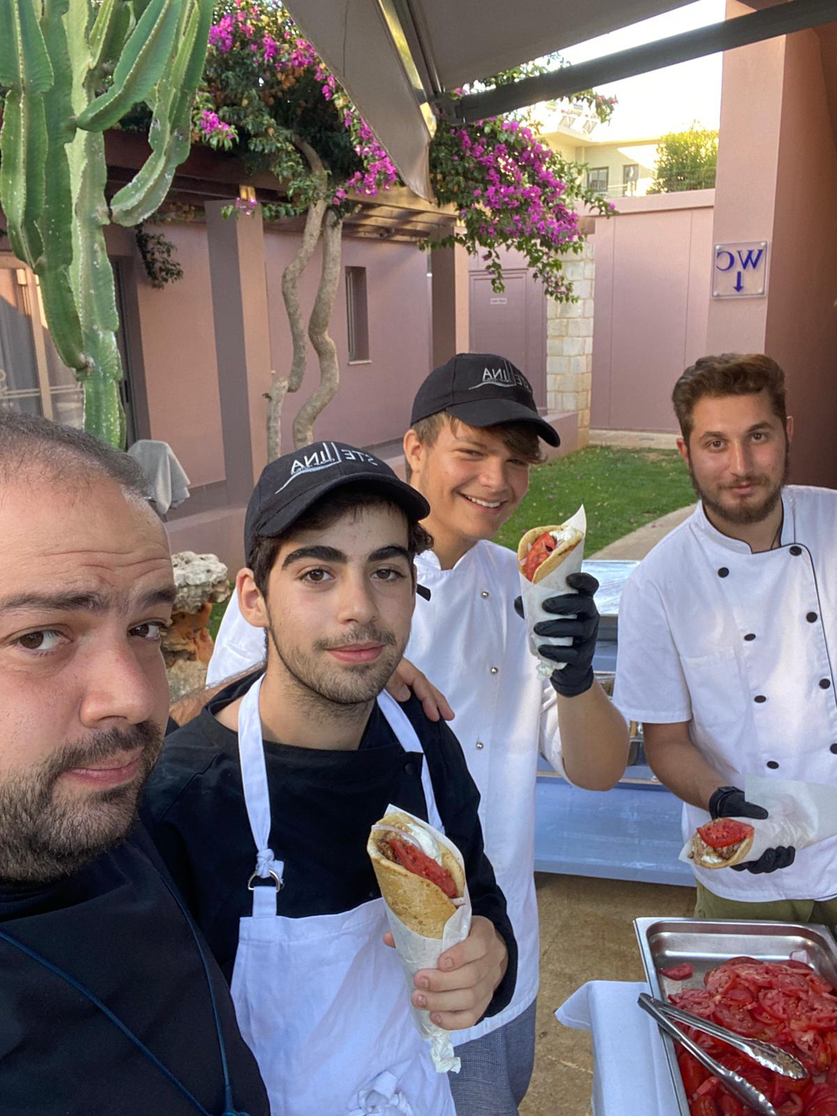

Slide 36
Magna Grecia
Laura Bucolo

Slide 37
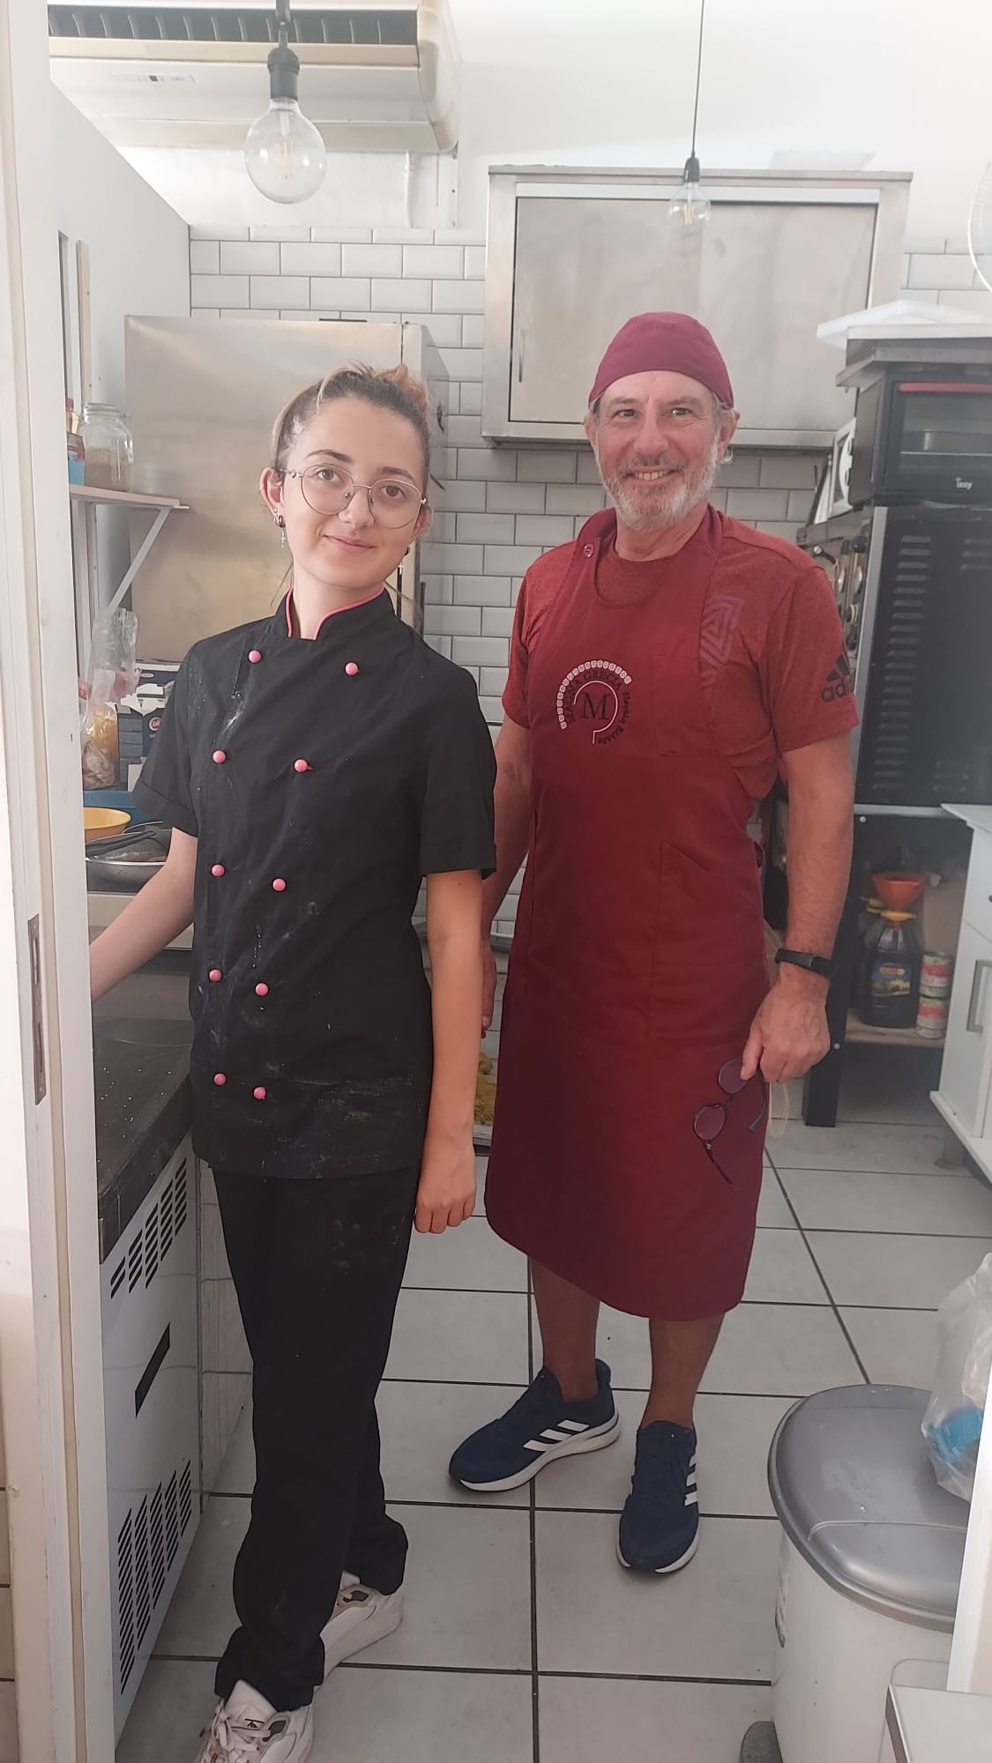
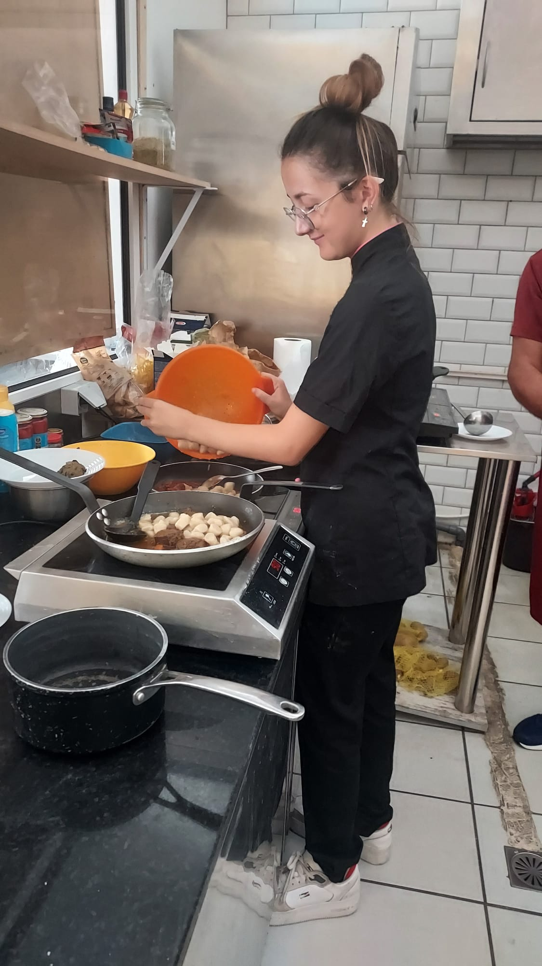

Slide 38
Okeanis Golden Resort
Lorenzo Campana
Margherita Del Brutto

Slide 39
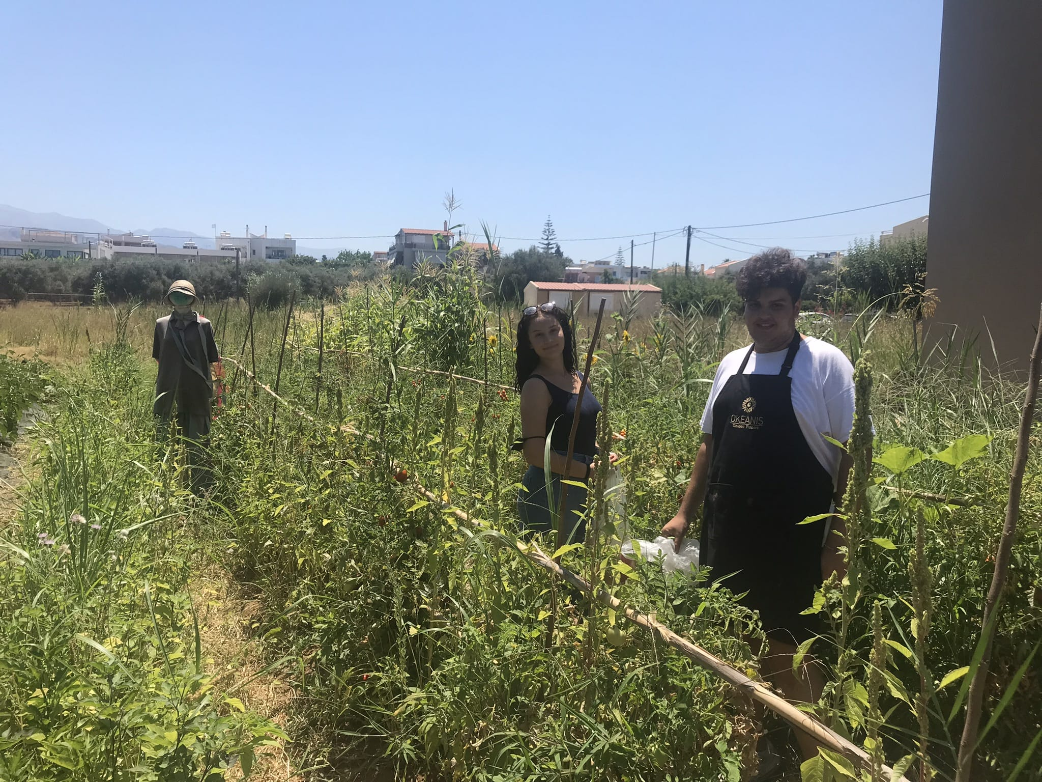

Slide 40
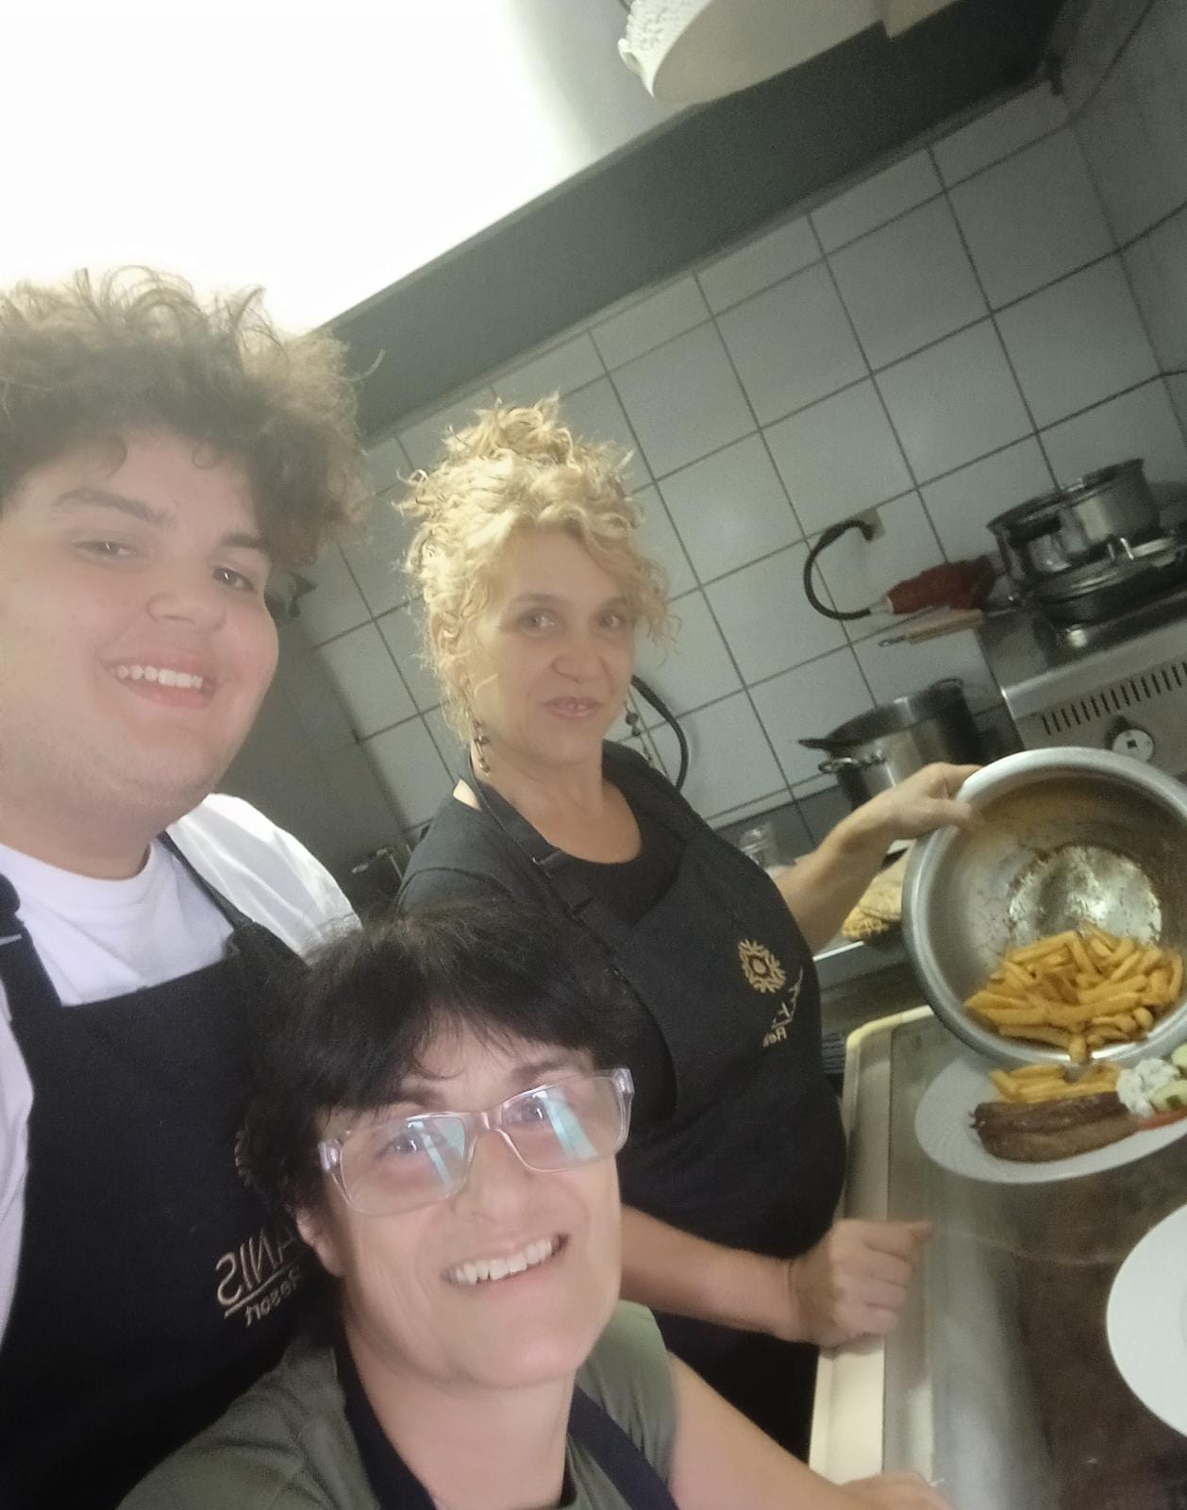
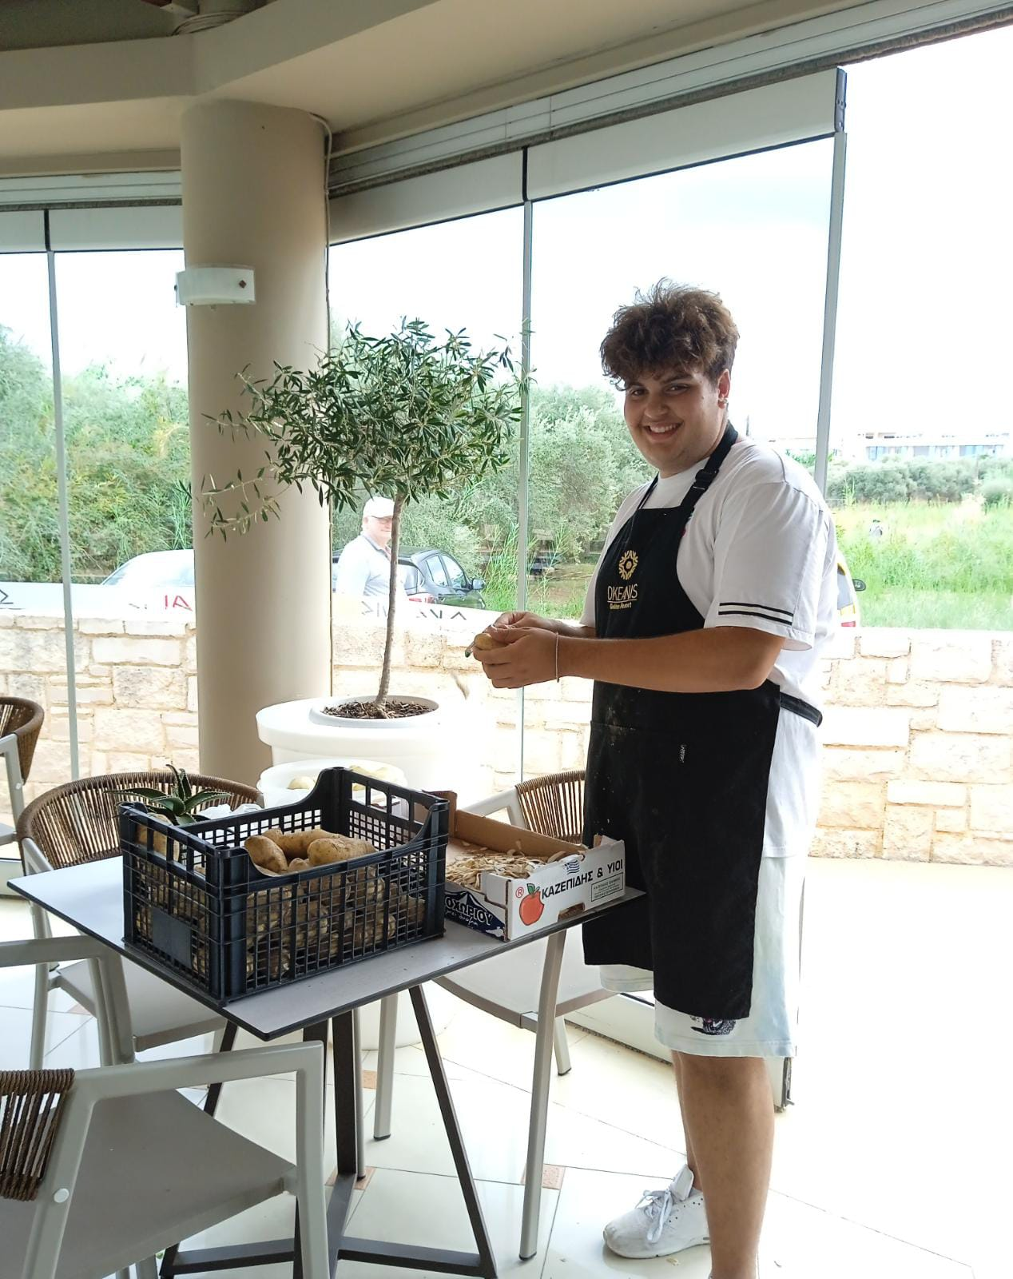

Slide 41
Balance Hotel
Ludovica Rivoli

Slide 43
Kiwi Apartments
Martina Proietti

Slide 45
Kedrissos Hotel
Federico Renzi

Slide 47
Atrion Hotel
Giorgio Longo

Slide 49
Golden Bay Suites
Eleonora Pangolino

Slide 51
The tutors
Andrea Bocchini
Bozena Kolodziej
Silvia Biribao
Ilaria Luciani
Romina Ferretti
Francesco Pagliari
Francesco Panfili
Beatrice Di Benedetto

Slide 54
BACKSTAGE

Slide 55
WORKING HARD…

Slide 58
HANGING OUT

Slide 60
SHOPPING

Slide 61
GETTING READY FOR THE BARBECUE

Slide 62
TAKING SELFIES

Slide 63
MOVING OUT

Slide 64
BUS 13

Slide 65
FISH
SPA

Slide 66
THANK YOU ALL FOR HAVING MADE THIS EXPERIENCE UNFORGETTABLE

