Slide 1
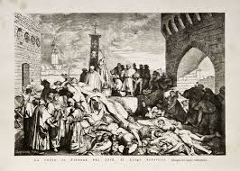
THE PLAGUE OF 1348

Slide 2
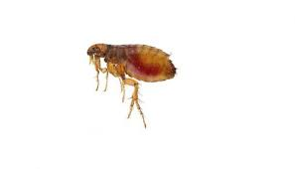
The plague is an infectious disease caused by a bacterium that lives in fleas
hosted by animals such as mice and rabbits
it was one of the most dangerous and catastrophic scourges that hit humanity.

Slide 3
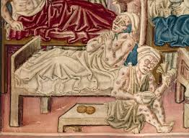
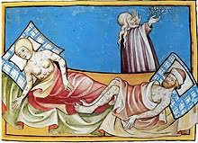
Thousands of people got sick and died in a few days or hours, the symptoms were cruding such as strong fever and the appearance of black bubos, from which it was attributed the name of “ The Black Death” or Bubonic Plague to the disease

Slide 4
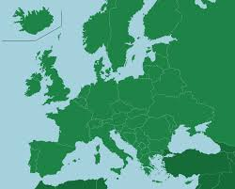
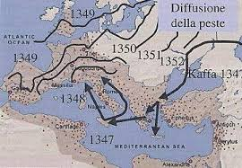
The plague came in Europe through the courses with Orient East. The intensiti European exchanges with the Asia became the vehicle of propagation of the epidemic.
The Genoese vessels that were coming back in Europe from the East, carried the plague in Constantinopdi’s hardbour first and than, in the Messina’s are. Genoa refused to receive its own infected ships, so thiej withdraw on Marseille and thien spread the contamination in the ports of the Mediterranean Sea.

Slide 5
At the beginning of 1348 the plague reached the hinterland and cities like Paris and London.
The death rate was verj higt and at east one third of the population of the Europe died

Slide 6
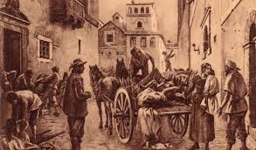
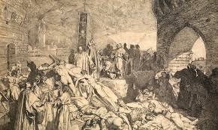
The most obvious cure was to leaving the areas of contagion
To Avoid the contact with deaths sick people and with their objects was fondamental:
In all cities were emaneted rigid regulations and the baides and good of the potients were buried or burnt.

Slide 7
The Black Plague remained in Europe for others two hundred years after the 1351, but until the 600 used to hit lightly and without involve di the continent.
Gabriele Tossini III B Sala

